Slide 1


Stronger Minds, Brighter Lives
Notes:
IT IS OKAY NOT TO BE OKAY. Let me repeat that again. IT IS OKAY NOT TO BE OKAY.
Hello – My name is Joy Landis and I am Senior Customer Manager for Mars Wrigley.
Raise of hands, how many of you feel comfortable enough to call your Director/Senior leader and talk about mental health? Whether you raised your hand or not, what was your first thought that came to your mind when I asked that question? Did fear come up? Worried about your job or the what they would think of you? Well, you are not alone.

Slide 2








The Wellness Tribe
Mission Statement:
Our team is committed to reframing the perception of mental health. We desire to end the stigma associated with mental health by encouraging all stake-holders of our organizations to be aware, to learn, and to implement practices that lead to positive mental health experiences.
Kelly King
Royal Farms
Benefits Manager
Joy Landis
Mars Wrigley
Senior Account Manager
Pamela Braga Andrade
EG America
Director Property Management
Raeven Haynes
Altria
Section Sales Director
Amy Hoelscher
JJ Gaming
VP of North America Sale
Operation
Andrea Kelley
Sunny Sky Products
Executive Director of Sales
Helena Yasmine
SEB Professional
Senior Account Manager
Notes:
Hi, my name is Kelly King. I am the Benefits Manager at Royal Farms. We are apart of Power Team 14: Mental Health. We refer to ourself as The Wellness Tribe.
Our mission statement is…..
Our group started right out of the gate. We determined our mission statement at this very meeting. In the beginning, we met about every 4 weeks until the start of the next year. We then began to meet every 6 weeks or so and had working sessions to accomplish as much as possible prior to the summer as we know everyone gets busy.
What we did:
Industry Survey
Additional Research

Slide 3
Mental Health Math: Survey & Research Results
(Survey results include > ½ were director level and above and > 6 years with their company)
IMPACT
COMFORT LEVEL
TRAINING GAP
68% No Mental Health training/ education over the last year.
13% Unsure of any company provided mental health resources
12% No mental health resources
Reduces absenteeism
Training is HUGE opportunity to help overcome stigma and barriers
95% Feel managers impact their overall mental health
64% Prefer a company with mental health resources
Builds retention
Increases employee satisfaction and productivity
29% Comfortable talking about mental health
30% Feel supported
40% Avoid seeking help
60% Fear judgment
Increases Trust: Builds stronger relationships between employees and employers
Notes:
To let you know over half who responded on the industry survey were director level and above and had been within their company for over 6 years.
We found three areas that kept coming up.
The impact mental health makes on associates.
The comfort level employees have when dealing with mental health
We noticed a training gap.
Mental health makes a large impact as we found 95% feel managers impact their overall mental health well. 64% prefer a company with mental health resources.
The comfort level of employees show that only 29% are comfortable talking about mental health and only 30% feel supported. We showed that 40% avoid seeking any help as there is even a larger number of 60% who fear judgment.
We also found was there was a training gap 68% that said within the past year there has been no mental health training or education within their organization.
13% responded that they were unsure of any company provided mental health resources while 12% said there was no mental health resources.
With our survey and research, we saw that when you have mental health free stigma environment and resources available, it increases employee retention and their overall satisfaction and productivity. It increases trust by building a stronger relationship between employees and employers. And reduces absenteeism.
Training above all is a HUGE opportunity to help overcome the stigma and barriers.

Slide 4
Break the Silence: Actions for Change
PREPARE!
Select the right time & setting
Communicate clearly & professionally
Collaborate –Bring Solutions
Develop a Plan
Check in Regularly & make adjustments
”What would America look like if the treatment and discourse surrounding mental health issues was destigmatized before it became life-threatening?”
Nurture a Healthy Work Environment
Notes:
So how can you break the silence?
Did you know that before seat belts were introduced, people thought it was terrible for an idea like that to be regulated by the government.
Seat belts are clearly beneficial and on of the most significant safety regulations when traveling.
Mental resilience is the new seat belt.
I love this metaphor as I borrowed it from a dear friend of mine Benj Gershman, bass player for a band called OAR, who has led a TED talk in which he references this. He asks the question of,
”What would America look like if the treatment and discourse surrounding mental health issues was destigmatized before it became life-threatening?”
Meaning, what if talking about Mental Health was as simply as asking someone how there day was? If Mental Health was talked about regular as eating your fruits and vegetables?
So how can you take the first step?
First before you begin to talk about it with your organization…PREPARE.
Reflect on what your concerns are in your organization.
Figure out what your personal needs are in your workforce.
Then, understand your rights.
There is Key Legislation out there that includes mental health and can empower you.
Americans with Disabilities Act -Protects individuals from discrimination based on disability, including mental health conditions
Family and Medical Leave Act -Allows eligible employees to take leave for certain medical conditions
Occupational Safety and Health Administration -Ensures safe working conditions, including mental health safety
Awareness of these rights can give you confidence when discussing your mental health with your employer.
It provides a foundation for advocating for necessary support and accommodations.
2. Select the right time and environment for the conversation.
Don’t pick the end of the year, during holidays or before your boss is going on vacation.
Don’t try to talk about this at an office party or happy hour.
Find a time when no one is rushed.
Look for a quiet space.
You want a calm and private setting as this can ease anxiety and foster a more open dialogue.
Communicate clearly and professionally.
Be direct, use ‘I’ statements to emphasize feelings and ownership of the situation.
Provide context and stay calm.
Share relevant information about how mental health concerns could be affecting work performance, productivity, or team dynamics.
Collaborate with your employer.
Bring solutions and engage in a productive discussion.
Do not start pointing fingers…this company doesn’t care about my mental health.
Have ideas or thoughts on how the organization can help in a specific situation.
This could mean talking about additional breaks, modified workload or access to support.
Explore options to help develop a support plan.
Think of a structured approach to manage mental health.
Look for specific strategies and resources to tailor individual needs.
This could include goals, action steps, resources that you might need.
Create regular check-ins and an evaluation method. Whether it is monthly, quarterly, bi-weekly.
This gives you a chance to make adjustments as needed.
Doing so will also continue the dialogue about mental health.
Keeping up the conversation can be as simply as starting off a team call with saying it is okay not to be okay.
You can nurture a healthy work environment.
Our team realized if we were leaving it to somebody else to help initiate that conversation, it might never happen because of the stigma and how uncomfortable it can be.
So be the one who starts the conversation.
Let others know it is okay not to be okay and help them put on their seat belt.

Slide 5
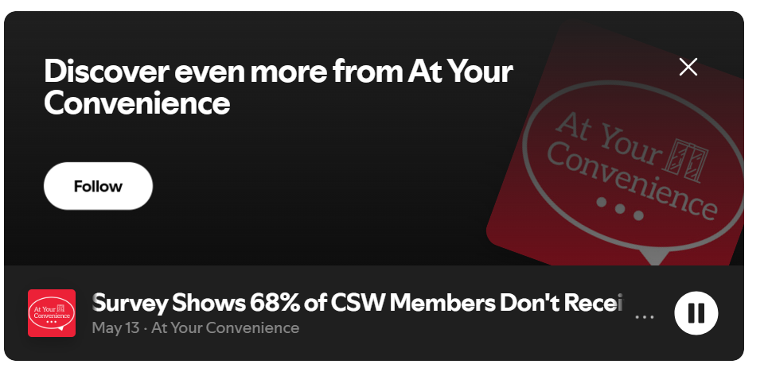
Resource Links
How to Talk to Your Employer About Mental Health - Moriah Behavioral Health
Click below image to listen to the podcast

