Slide 1
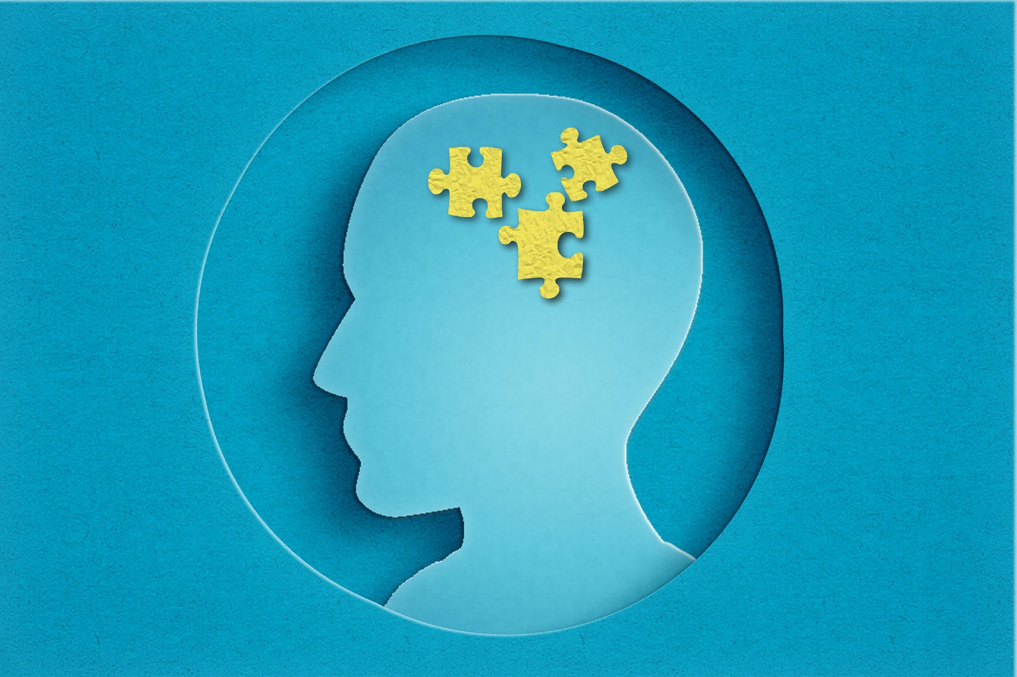
Emotional Intelligence
Notes:
Kristy

Slide 2
Power Team 7 - Contributors
Taylor Nelson
Jillian Fusco
Niki Mason
Kathy Kilburg
John Coyle
Alyssa Mince
Monica Dyakanoff
Kristy Clement
Notes:
Monica

Slide 3
What is Emotional Intelligence (EQ)
Understanding Physical Limitations of the Brain
The physical & chemical side of emotion
Emotional Intelligence in Actions
Self Talk & Thought Rewiring The Power of Thinking
Resources
Notes:
Monica - edit this to match sections

Slide 4
Emotional Intelligence (EI), also known as emotional quotient (EQ), is the ability to understand, manage, and use emotions effectively, both in oneself and in others. It encompasses skills like self-awareness, self-regulation, empathy, and social skills. Emotional Intelligence is the capacity to recognize, understand, and manage emotions, as well as to recognize and influence the emotions of others.
EMOTIONAL INTELLIGENCE
Notes:
Monica

Slide 5
UNDERSTANDING PHYSICAL LIMITATIONS OF THE BRAIN
THE PHYSICAL & CHEMICAL SIDE OF EMOTION
Notes:
Kristy

Slide 6

An Emotional Hijacking
What we Experience:
Extreme emotion that may later seem uncalled for
Can be positive or negative - anger, sadness, or happiness
“Don’t know what came over me”
Happens fairly frequently
Can lead to extreme action in rare situations

Slide 7
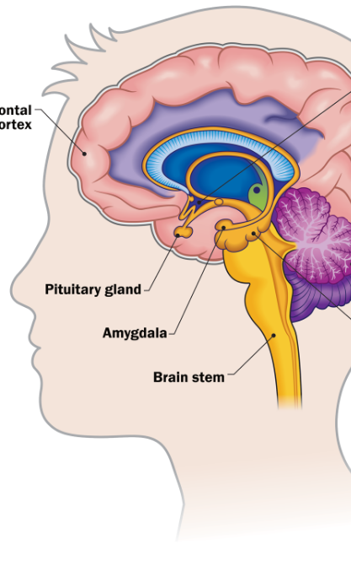
The Responsible Anatomy
The Amygdala
Responsible for emotional hijackings
2 almond shaped clusters of interconnected structures - one on either side of the brain above the brainstem at the bottom of the limbic ring.
The Amygdala weighs emotional significance
It is the store house for emotional memories

Slide 8
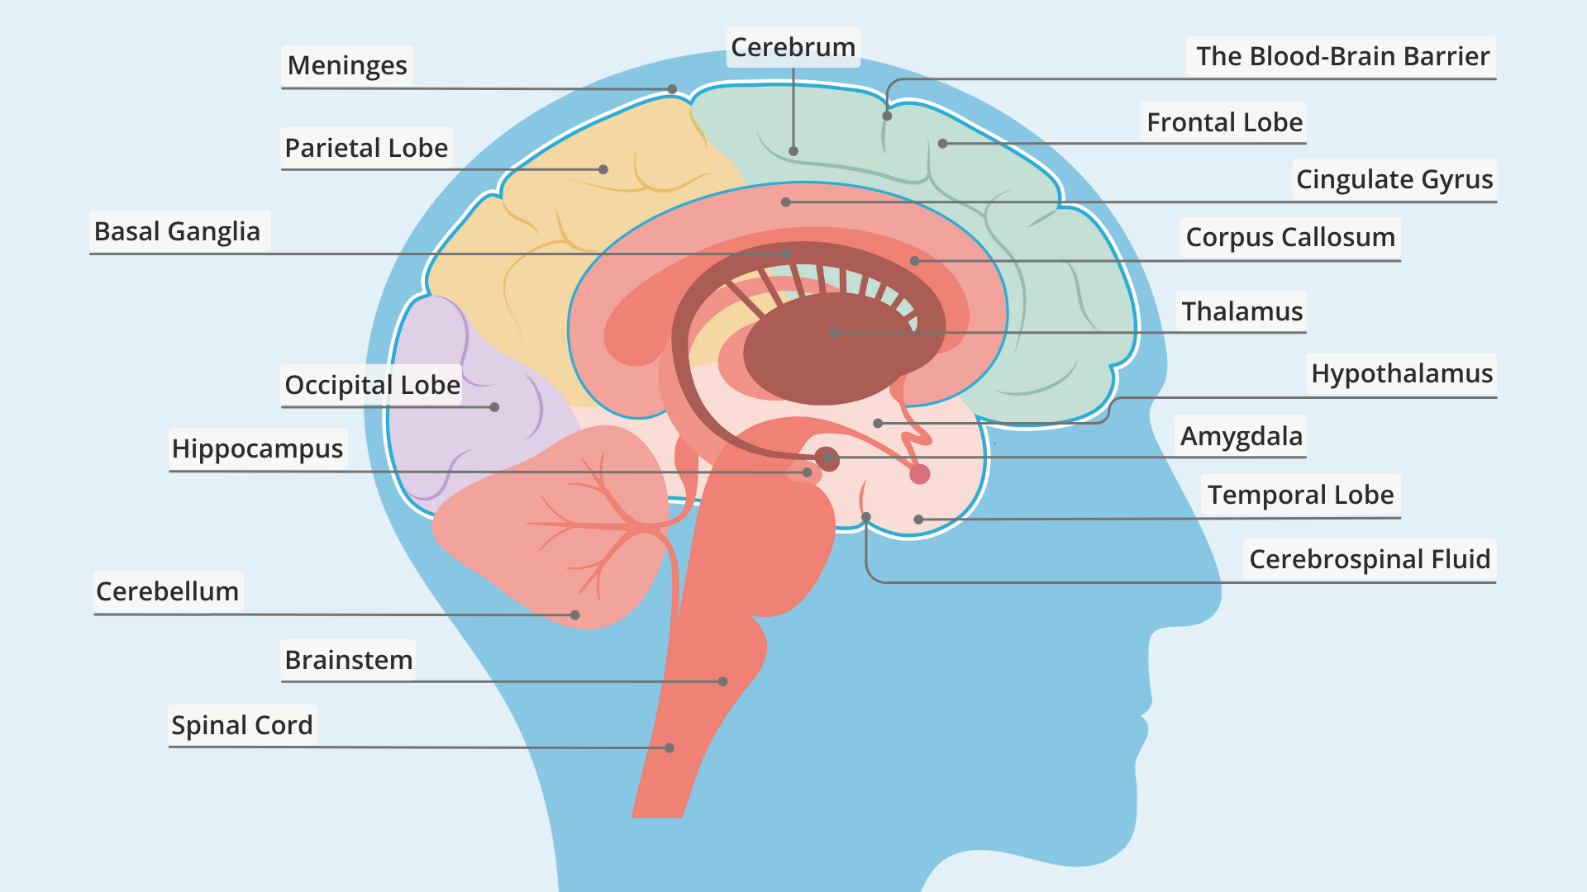



Slide 9
The Standard Arrangement
Typically, the prefrontal brain areas govern our emotional reactions from the start
The largest projection of sensory information from the thalamus is coordinated by the frontal lobe
A "cascading series of circuits registers and analyzes that information, comprehends it and through the prefrontal lobes, orchestrates a reaction. If in the process, if an emotional response is called for the prefrontal lobes dictate it working hand-in-hand with the amygdala and other circuits in the emotional brain"

Slide 10
Emotional Sentinel
1. Information travels from ear or eye—> Thalamus
2. Thalamus —> Amygdala via single synapse - arrives first
3. Thalamus —> Second signal to neocortex (thinking brain)
LeDoux found that emotional reactions and emotional memories can be formed without any conscious, cognitive participation at all.
Due to the Bundle of neurons that connect from thalamus to the amygdala - allows faster reaction from the amygdala before we even "know" why from our senses. It is in a priority position to hijack the brain in emergencies - or perceived emergencies

Slide 11
The Neural Tripwire
If this:
Then this:
Incoming signals from the senses let the amygdala scan every experience for trouble
Asks is this something I hate? Fear? Will it hurt me?
If the answers is yes, the amygdala sends a message of crisis to all parts of the brain
The Amygdala's extensive web of neural connections allows it to capture and drive much of the rest of the brain during an emotional emergency - including the rational mind.

Slide 12
Emergency Signal
What happens when the answer is yes
Signal is sent to
Secrete the body's fight or flight hormones
Mobilize centers for movement
Activate the cardiovascular system , the muscles and the gut
Signal the secretion of the hormones that heighten reactivity of key brain areas including those that make the senses more alert
Various systems do various jobs - cause facial expressions, raise blood pressure, slow breathing, increase heart rate
Cortical memory takes presence over strands of thought - retrieve any knowledge relevant to the emergency on hand

Slide 13

Out of Date Alarms
The downside is that the emergency signal from the amygdala is often out of date in the modern fluid world humans live in with other humans
Would be fine if we were squirrels!
We are complex human beings!

Slide 14
More Downside
Sloppy circuit: The Amygdala's method of comparison is associative, not specific, and will call it a "match" and frantically demand that we act to the present as we would have long ago.
The Amygdala matures quickly and begins emotional memory from early on.
Our brain's imprecision is added to by the many potent emotional memories that date from the first few years of life - infant and caretaker relationships
LeDoux: “…when these emotional memories are triggered in later life there is no matching set of articulated thoughts about the response that takes us over".

Slide 15
The Emotional Manager
The amygdala's damper is the prefrontal cortex
Emotional hijackings have two dynamics - the trigger of the amygdala and a failure to activate the neocortical processes that usually keeps emotional response in balance

Slide 16

The “off” switch
When the “standard arrangement” is hijacked by the amygdala, research shows that the left frontal lobe has the ability to act as an off switch, dampening the signal to the rest of the brain and body.
The left frontal lobe can act like a parent stopping a child
Practice: Notice this happening. Understand it’s a chemical reaction but then we can retake conscious control.

Slide 17
Emotional Intelligence in Action
Self Talk & Thought Rewiring

Slide 18

Impact of Self-Talk
Self-talk shapes beliefs, behaviors, and emotional responses significantly.​
Positive vs Negative​
Positive self-talk fosters resilience; negative leads to doubt and low motivation.​
Awareness and Change​
Recognizing and shifting negative patterns enable healthier mindset development.​
Empowerment Through Self-Talk​
Constructive self-talk empowers emotional well-being and personal growth.
Notes:
We can all think of times that self-talk impacted us, either positively or negatively. Many times negative examples come to mind where we were over thinking a situation or doubted ourselves. The inverse is just as positive.. EMOTIONAL HIJACKING

Slide 19
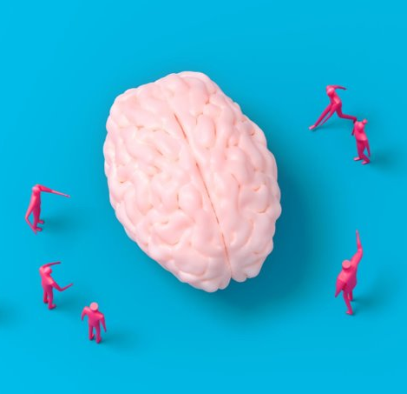
Benefits of Positive Self-Talk
Enhances Motivation and Optimism​
Positive self-talk activates the brain’s reward system, boosting motivation and optimism.​
Reduces Stress and Anxiety​
It lowers cortisol hormone levels, reducing stress and improving emotional regulation.​
Improves Performance and Recovery​
Positive self-talk helps people perform better and recover faster from setbacks.​
Builds Confidence and Resilience​
It boosts self-esteem and resilience, enabling confident and composed responses to challenges.
Notes:
Like most things, practice makes perfect. The more you positive self-talk, the better you will be at it. This will allow you to bounce back from setbacks faster and work better under pressure. EMERGENCY SIGNAL

Slide 20

Practicing Positive Self-Talk
Awareness: Notice your inner dialogue​
Challenge: Question negative thoughts. Awareness of Inner Dialogue​
Recognize your thoughts to understand if they are positive or negative. Journaling helps track and reflect on these patterns.​
Challenging Negative Thoughts​
Question the validity of negative thoughts and explore their causes to begin shifting perspective.​
Replacing with Positive Affirmations​
Substitute negative thoughts with positive affirmations using visualization and affirmation tools for reinforcement.​
Repetition for Habit Formation​
Consistent practice rewires the brain, enhancing emotional resilience through mindfulness, meditation, and journaling.
Notes:
Here are 4 steps to get you started: OUT OF DATE ALARMS
Awareness: is your inner dialogue positive or negative? By journaling daily, you can track where you land on the self-talk spectrum
Challenge: if its negative, why is that? What’s going on to create this dialogue in your head?
Replace: trying taking the opposing view to your negative thoughts. What’s the other way someone could look at the same situation? What would you tell someone else if they were sharing these thoughts with you?
Practice, practice, practice to make it a habit!

Slide 21
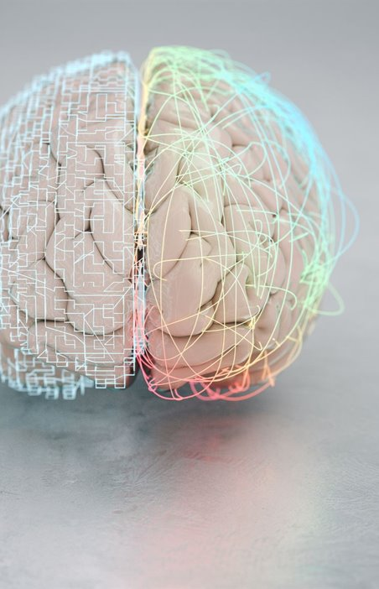
Rewiring Your Brain
Enhancing Self-Awareness​
Understand your values, emotions, and behaviors to recognize emotional triggers effectively.​
Techniques for Self-Management​
Use deep breathing, mindfulness, and journaling to regulate emotions and process feelings.​
Building Resilience and Delaying Gratification​
Develop resilience and patience to make thoughtful decisions and handle stress better.​
Lasting Brain Changes​
Consistent practice rewires brain to improve emotional regulation and interpersonal skills
Notes:
Our thoughts are emotional responses
Emotional Intelligence isn’t just about reacting well it is about rewiring how we think
When we change our beliefs and thought patterns, we literally reshape our brains pathway's
Like a muscle, the more you practice the stronger your control
NEURAL TRIPWIRE

Slide 22

Social & Relationship Awareness
Empathy and Perspective Taking​
Understanding others' perspectives and responding with compassion fosters emotional connection.​
Nonverbal Communication Awareness​
Observing body language and tone reveals emotions and intentions beyond words.​
Active Listening Skills​
Listening attentively and showing understanding builds trust and strengthens relationships.​
Conflict Management and Communication​
Clear expression and constructive conflict resolution promote harmonious social environments.
Notes:
Strong relationships are built on trust, communication and conflict resolution
Build rapport by being authentic
Communicate clearly and respectfully
Listen to understand do not plan your response in your head HEAR them
When conflict arises look for win-win solutions (solution oriented)
Use cognitive reframing-shift your perspective to see challenges differently

Slide 23

Additional Tips for Growth
Seek Feedback​
Getting feedback reveals your communication strengths and areas to improve effectively.​
Read and Learn​
Reading expands knowledge and introduces new emotional intelligence development strategies.​
Practice Mindfulness​
Mindfulness improves self-awareness and emotional regulation for clearer responses.​
Engage in Courses​
Online workshops provide structured tools and practical skills for emotional growth.
Notes:
EQ is lifelong journey
Keep learning and read, take courses and solicit feedback
Mindfulness helps you stay present and aware
Be patient
Nolan Story with Dr Susan Fix

Slide 24

My Brothers story
Aurora Borealis over Anchorage Alaska
Notes:
Nolan Story with Dr Susan Fix

Slide 25
Presenters
Monica Dyakanoff - Sunny Sky Products
mdyakanoff@sunnyskyproducts.com
Kristy Clement – Johnny’s Markets
kclement@waltersdimmick.com

Slide 26
Resource:
Emotional Intelligence: Why it Can Matter More than IQ
Chapter 2: Anatomy of an Emotional Hijacking
*based on research by neuroscientist Joseph LeDoux.
Notes:
Can we move this to the end as a resource slide? Add sources for Monica/Nikki section

