Slide 1

Fuel the Future: Women Owning Their Development

Slide 2
Empowering Women Leaders in the C-Store Industry
Identify and own your unique leadership style
Leverage your strengths—both natural and learned
Engage meaningfully through mentorship and networking
Drive sustainable results with confidence

Slide 3
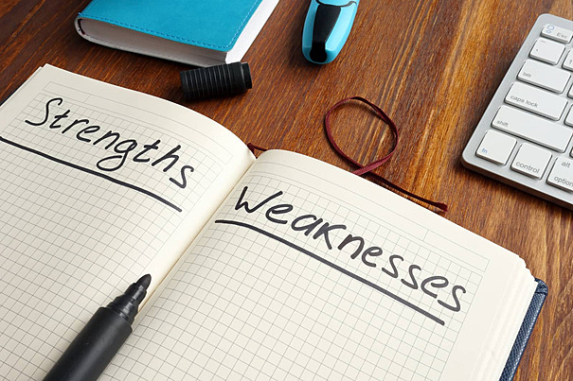
Know Your Strengths, Bridge Your Gaps

Slide 4
Strengths are made up of your Natural Abilities and Learned Skills
Natural Abilities
“Hardwired" way your brain tends to operate
Feels effortless and energizing when you use them
Talents or Aptitudes
Example: An innate ability to connect with people and build rapport (empathy, relationship-building)
Learned Skills
Developed through education, training, practice, and experience
Effort and dedication to learn and master.
Technical skills or acquired competencies
Example: Proficiency in a specific software program (e.g., Python, Photoshop, Salesforce)
Notes:
You will reach optimal productivity faster if you lean on what you already do well

Slide 5

Bridging the Gap: Awareness into Growth
Bridging Your Gap Means...
- Using your strengths to tackle what's uncomfortable
- Turning awareness into action
- Seeking feedback and applying it with intention
Ask Yourself:
"Where does my strength create a blind spot?"
"What's one skill I need to develop to balance it?"

Slide 6

By understanding both your natural abilities and your learned skills, you can strategically focus on developing your inherent talents and aligning them with purposeful learning to maximize your potential and find greater fulfillment in your role.

Slide 7

Discover Yourself With the Right Tools
Leverage 360° feedback tools and Self-assessment
Career Planning Workbook
Myers-Briggs Type Indicator (MBTI)
Predictive Index Assessment
DISC Assessment

Slide 8



Strong Leaders Build Strong Networks
Mentorship and Networking

Slide 9

The Power of Networking
Opens doors to mentorship and opportunities.
Join Employee Resource Groups (ERGs) or attend industry events.
Build sponsors and allies, not just contacts.
Women with strong networks are more likely to advance.

Slide 10

Mentorship Guidance
A mentor guides, challenges, and supports your personal growth
Mentorship can be situational — one for career planning, another for confidence-building
Storytelling is a key tool in effective mentorship
Focus on dialogue, not direction

Slide 11
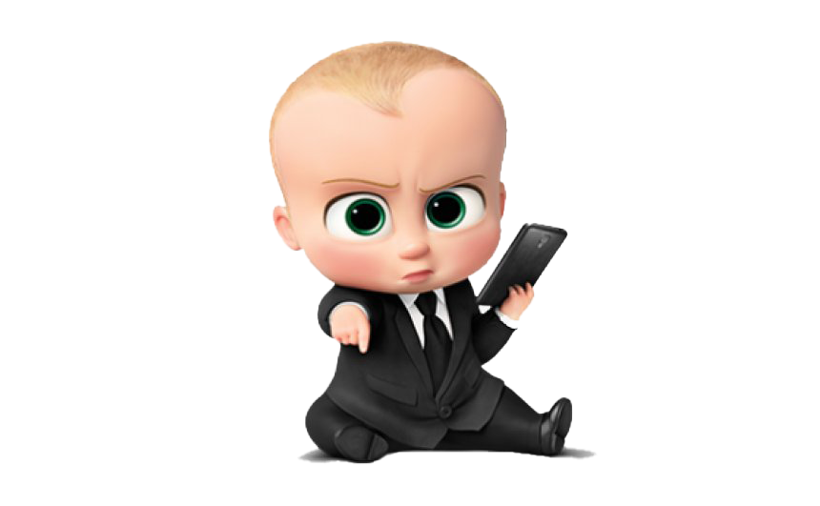

Boss or Mentor — What’s the Difference?
Boss
Focuses on results
Offers short-term direction
Gives directions
Hierarchy-driven
Provides performance feedback
Mentor
Encourages exploration
Offers long-term guidance
Asks questions
Relationship-driven
Helps build self-awareness
ThePhoto by PhotoAuthor is licensed under CCYYSA.
Notes:
You will reach optimal productivity faster if you lean on what you already do well

Slide 12
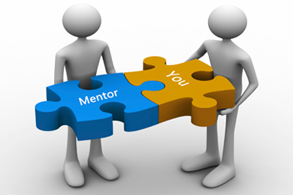
No Rule Book
You may find mentorship outside of your organization — that's okay!​
As you evolve you could grow out of your mentor – that's okay!
Seek mentors aligned with your aspirations, not just your role.

Slide 13

Fueled by Feedback
Be Vulnerable and Receptive to Feedback
Feedback is a gift—it's about growth, not judgment
Create a safe space for honest input from peers, mentors, and team members
Recommended Resources​
Thanks for the Feedback
by Douglas Stone & Sheila Heen​
Radical Candor
by Kim Scott

Slide 14

Achieve
Fueled
Results
Sustain
Repeat

Slide 15
What it Takes to be a Great Leader
Leadership is about inspiring, motivating and guiding your team to a shared vision and goal
Success is a collective effort, and is not achieved alone
The way you lead impacts how a team functions and gets results
Setting the right tone for culture in the workplace, fostering collaboration and encouraging open communication will create a cohesive high performing unit

Slide 16
Traits of an Effective Leader
Strong Communication Skills
Articulates vision, provides constructive feedback, listens to their team
Emotional Intelligence
Created a positive and empathetic work environment
Delegation & Empowerment
Gives team autonomy to take ownership of their work
Adaptability
Adjusts leadership style for different situations & individuals
Strategic Thinking
Sees the big picture, anticipate challenges, align with company values

Slide 17

The Key to Long Term Success Strategic Leadership
Leadership is a journey, not a destination. If you continually develop your leadership skills and adapt your approach, you can create a productive and passionate team
Develop and Repeat
Drive Results through Effective Leadership
Leverage Mentorships and Networking
Identify your Strengths and Opportunities

Slide 18

Resources
Assessments
Learned Skill Assessments
Natural Talent Assessments
Tools
Career Planning Workbook
Books
Articles
10 Leadership Strategies to Improve Team Performance and Drive Success
Leadership is the Art of Releasing Greatness in Others
Your Manager is not Your Mentor Stop Confusing the Two
How to be Strategic with Employee Resource Group for Women
Radical Candor by Kim Scott
Thanks for the Feedback by Douglas Stone &Sheila Heen

Slide 19

Empowering Women Leaders in the C-Store Industry
Identify and own your unique leadership style
Leverage your strengths—both natural and learned
Engage meaningfully through mentorship and networking
Drive sustainable results with confidence

