Slide 1

Work Life Balance
Wisdom for Healthier Work-Life Harmony

Slide 2
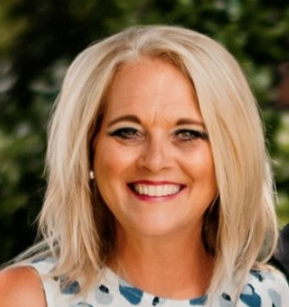
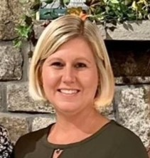
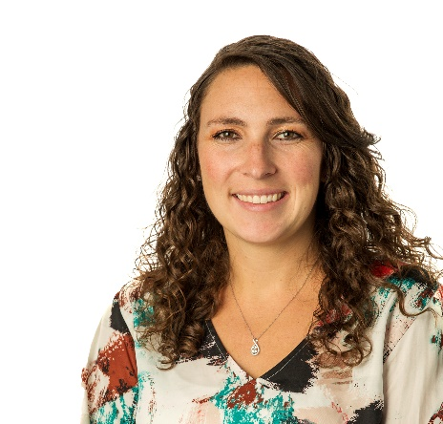



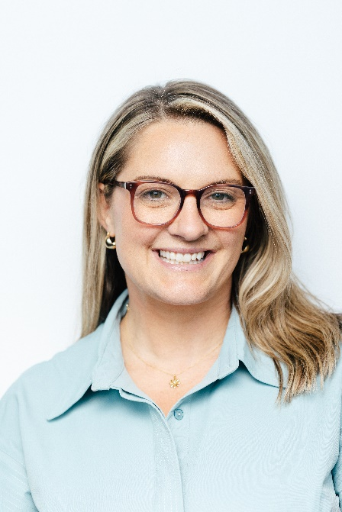
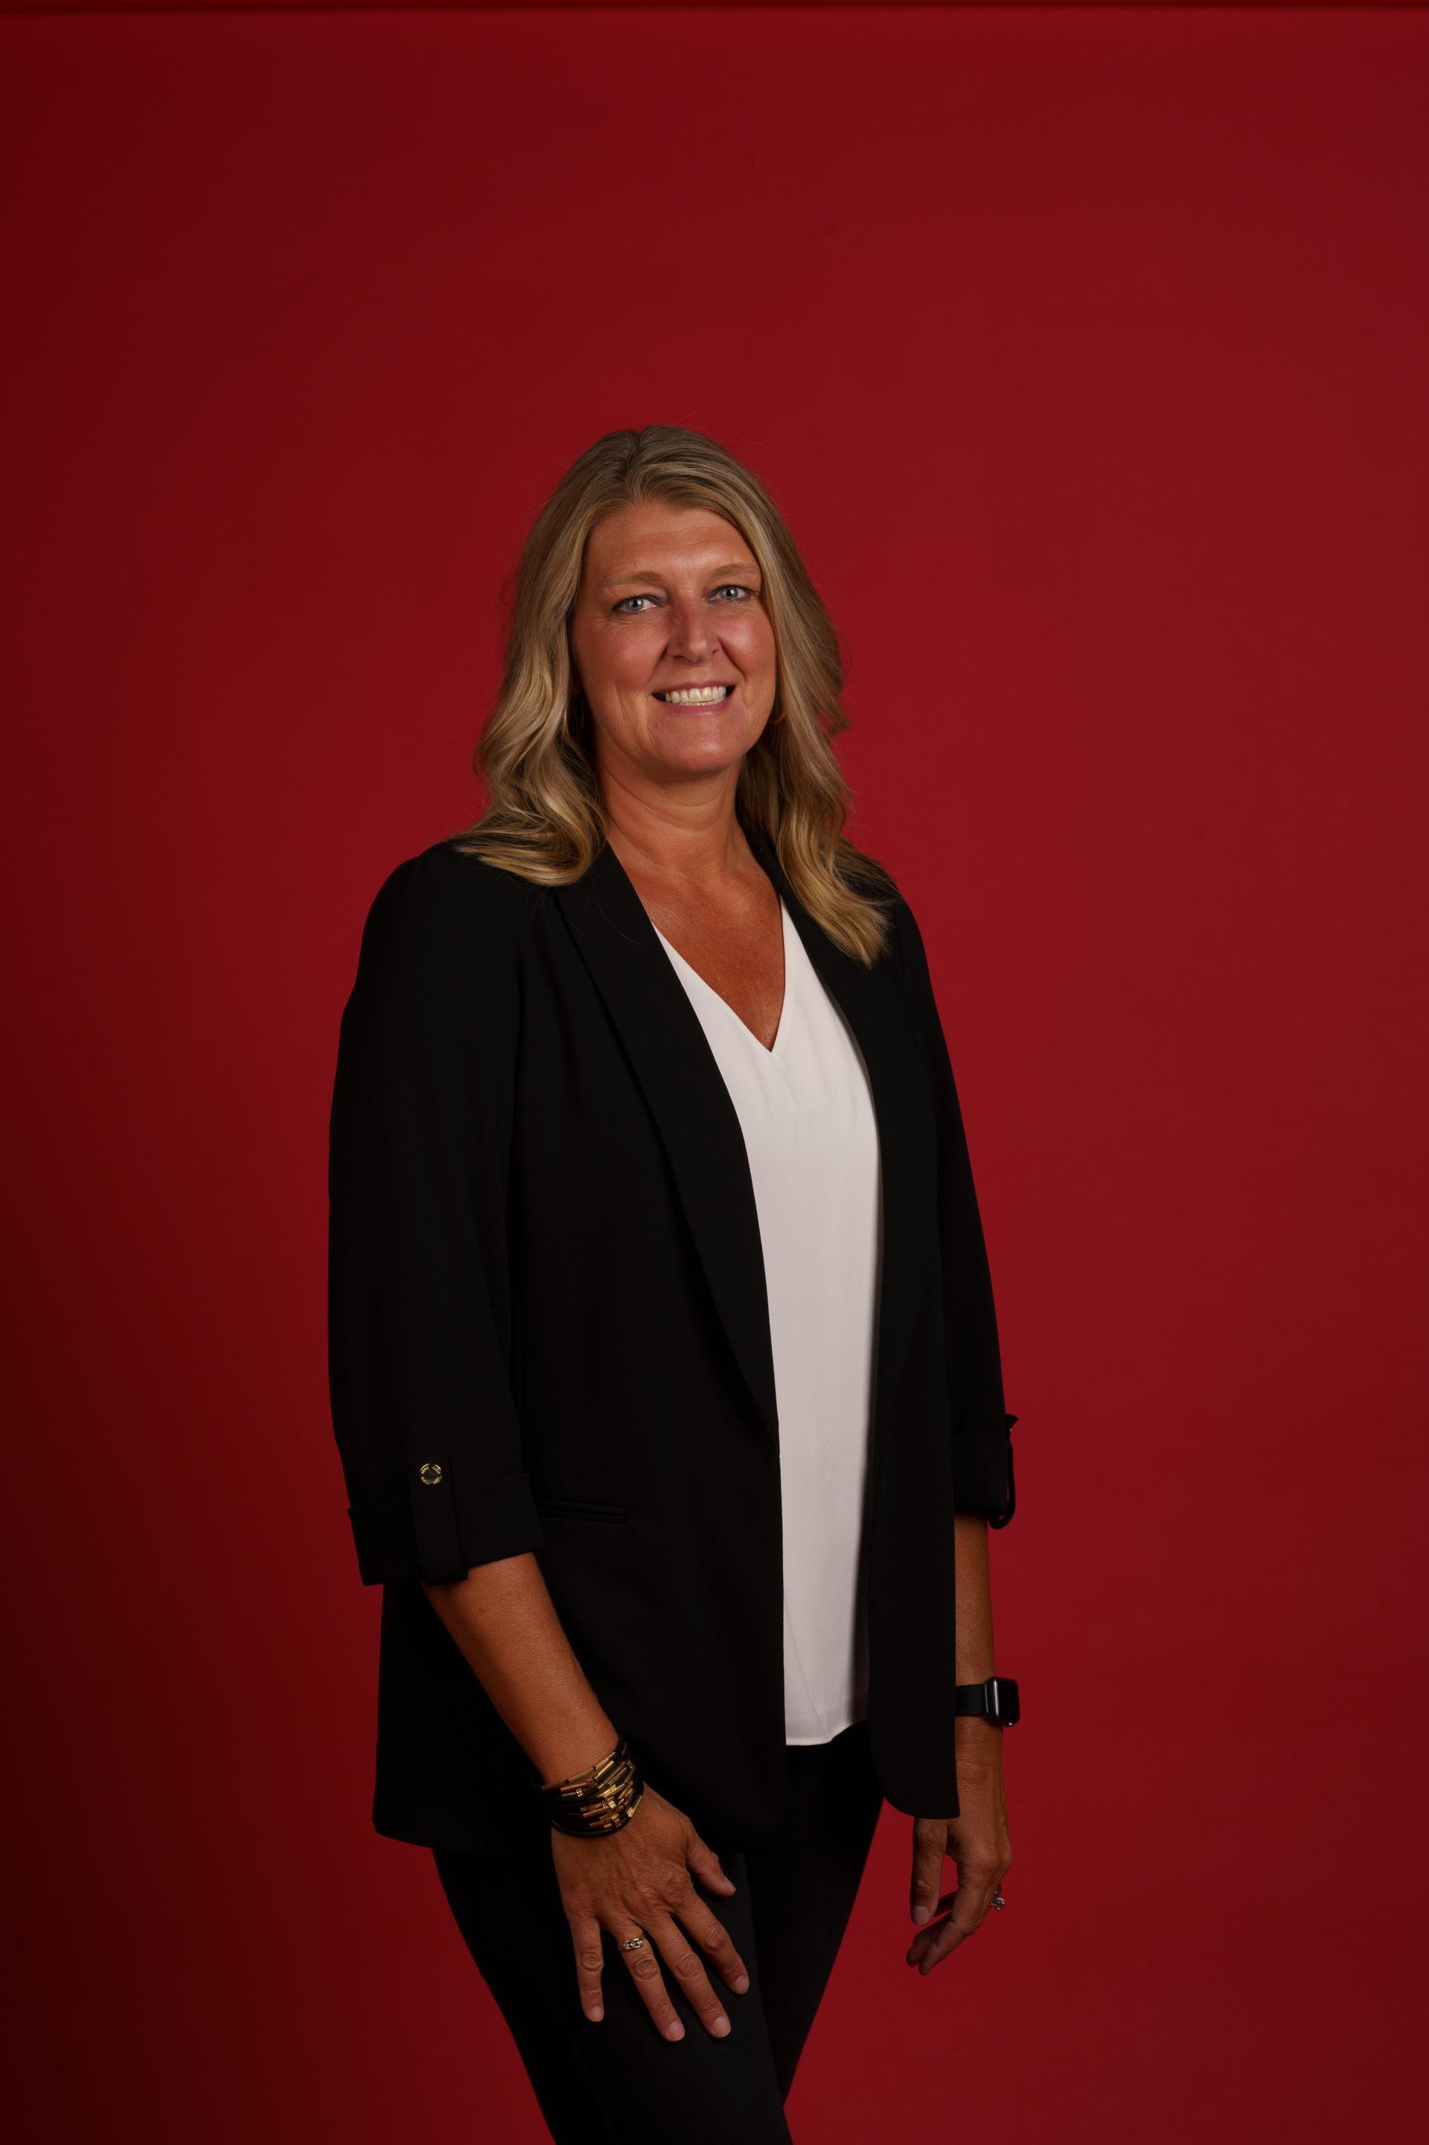


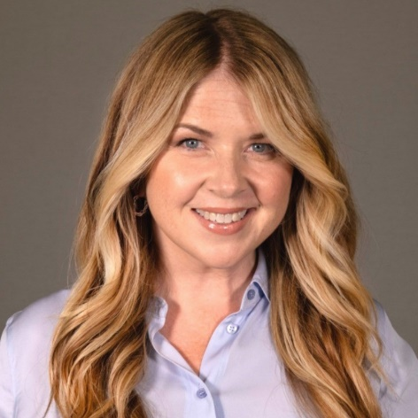
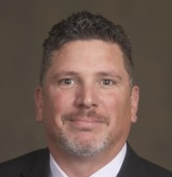
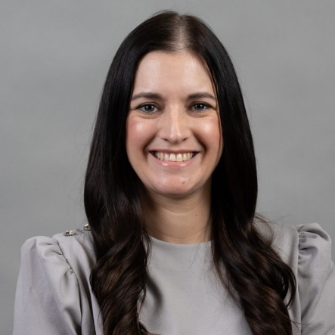



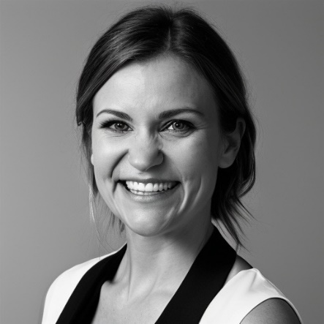
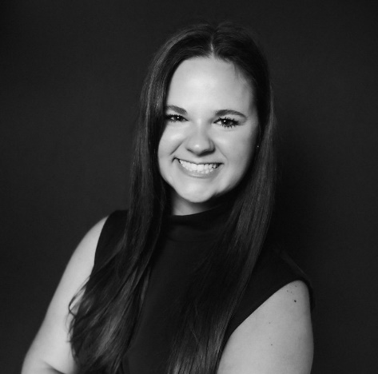


PRESENTERS
Tina Edmonson
Heather Clay
Aleah Stealey
Regional Account Manager
Sr Director Pricebook & Merch Support
Director of Operations
TEAM MEMBERS
Nikki Fales
Krista Rehm
VP, Marketing & Payments
Bakery Category Analyst
Brandi Goodin
Greg Hetfield
Codi Warren
VP Marketing Communications
Director of Sales
Manager, Digital Marketing Ops
Rebekah Lamphere
Emily Dendy
Director, 7-Eleven & Speedway
National Account Manager

Slide 3
Survey Says:

Slide 4



Do not edit
How to change the design
How would you rate your current work-life balance?
The Slido app must be installed on every computer you’re presenting from

Slide 5
Takeaway #1: NO Benchmarking

Slide 6
Takeaway #2: Strong Voices

Slide 7

How to
Take Action at Each Pillar

Slide 8
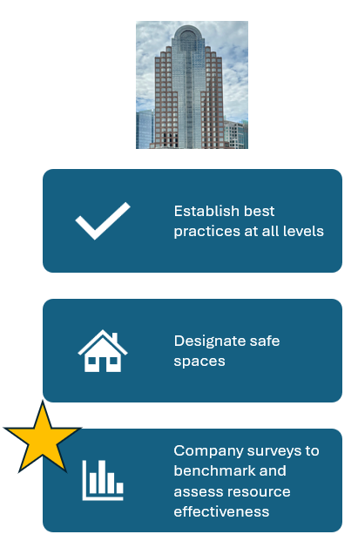

Slide 9

Do not edit
How to change the design
Choose the option below that best fits your company's current work-life balance policy status.
The Slido app must be installed on every computer you’re presenting from

Slide 10
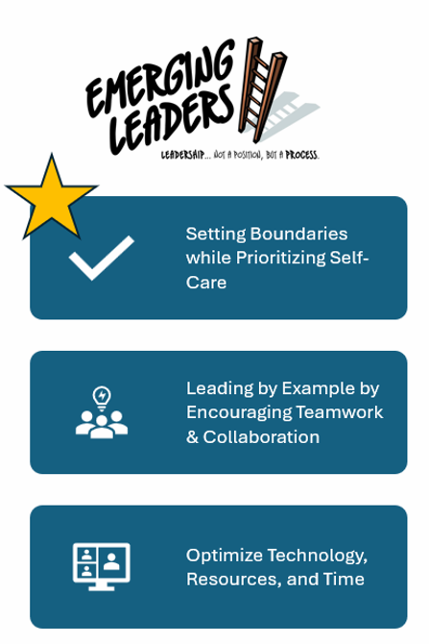

Slide 11
Do not edit
How to change the design
Rate how this statement relates to you. "My work-life balance boundaries positively impact my abilty to effectively prioitize self-care."
The Slido app must be installed on every computer you’re presenting from

Slide 12
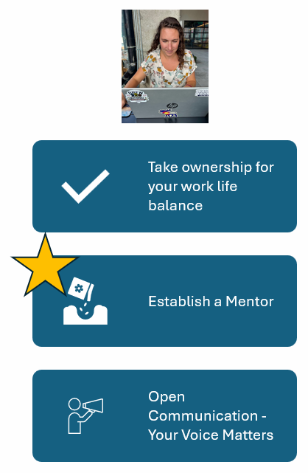

Slide 13
Do not edit
How to change the design
Do you have a mentor?
The Slido app must be installed on every computer you’re presenting from

Slide 14
Tried and True Stories
“No-Meeting” Fridays
  “During covid, our manager implemented “no-meeting” Fridays since we were on Zoom all day. It has stuck and now everyone knows they have Friday to catch up or even step out early if they need to.” – Manager, Sales Operations
Create an End-of-Day Ritual
  “Every day at 6PM, I shut my laptop, no matter what’s on my plate. If I can't solve it in business hours, I’m not managing my time- or my team- well.”- VP, Marketing
Family first, calendar second
  “Once our VP put her kids’ school events in her calendar. It send a clear message that personal time matters- and we can all respect that time.” – Sales Manager
Flexible Work Environment
  “The tasks or projects can get done just as effectively outside of a strict 9-5 schedule. I empower my team to utilize the flexibility to balance their personal needs while still accomplishing business objectives successfully.” – Sr. Director, Marketing/Merchandising

Slide 15
Inspiring Others
“The question I ask myself like almost every day is, ‘Am I doing the most important thing I could be doing?’ … Unless I feel like I’m working on the most important problem that I can help with, then I’m not going to feel good about how I’m spending my time. And that’s what this company is.”
“Managing compassionately isn't merely a strategy for team-building; it's foundational for constructing a thriving company.”
Jeff Weiner, former CEO and current Executive Chairman at LinkedIn
Mark Zuckerberg, Co-founder, Chairman and CEO of Meta Platforms

