Slide 1

Corporate Sponsorship Program
December 1, 2026
Metro Toronto Convention Centre, South Building

Slide 2

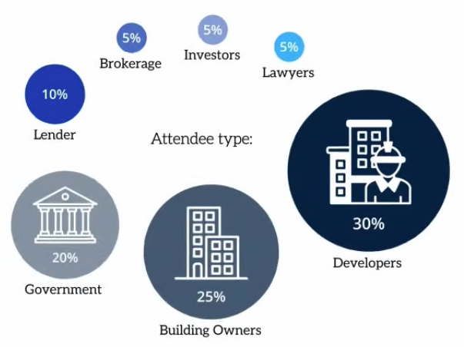
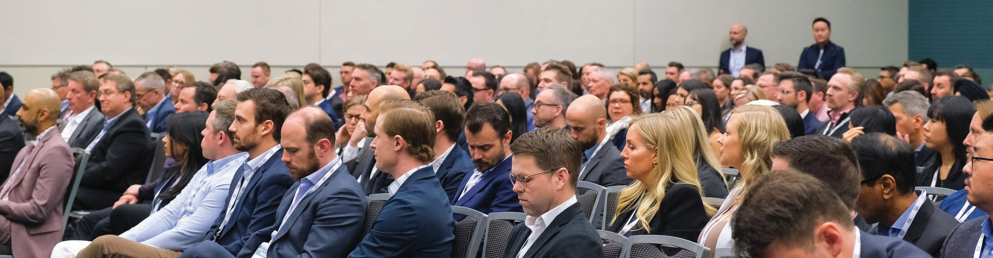
Are you ready for the apartment boom?
After years of challenging development climate, the demand for apartments is surging. Fueled by the government's upcoming budget and focus on new rental housing.
250+ decision-makers are set to gather in Toronto for actionable insights, high-impact networking, and strategies to seize emerging business opportunities.
With expert keynotes, real-world case studies, and timely market updates, this year's program will accelerate learning & decision-making.
Join us for an event like no other, at this year’s Apartment Development & Affordable Housing Conference — designed to deliver real solutions, address development challenges, and unveil systems that streamline projects. This is the event that shatters the status quo and propels the industry forward toward a brighter, problem- solving future.
BE AMONG THE FIRST TO REGISTER and claim your gift, as the first 75 registrants will receive a copy of the #1 Amazon Best Seller, The Self-Funding House™, or choose the second book in the series The Blueprint for Your Self Funding House™, which will be received in person at the event.
Benefits for all sponsors
Complimentary conference registrations
Logo exposure on the event website page for a nine-month period
Placement of your logo on signage at the conference
Database of all conference delegates (no emails) will be provided two weeks prior to as well as following the event
Complimentary tickets to the Real Estate Forum Chairs’ Reception on December 1 at the Fairmont Royal York with over 2,800 attendees.
We invite you to read on for additional exposure based on sponsorship level.
Who will attend
250+ attendees include:
Front & Centre
The Apartment Development & Affordable Housing Conference sponsorship opportunities have been designed to ensure that sponsors receive maximum corporate exposure to all the attendees before, during and post event. Each sponsorship level will offer a different package of value- added benefits for participating organisations.
        To secure your sponsorship or for more information, connect with:
        Frank Scalisi
        Director of Sales
        Tel: 416.512.3815
        Email: frank.scalisi@informa.com
        Website: realestateforums.com

Slide 3
Sponsorship opportunities
Level | # of Opportunities | Commitment
Title | One opportunity | TAKEN
Platinum | Four opportunities | $20,000.00
Gold | Six opportunities | $15,000.00
Plenary Session | Five opportunities | $6,000.00
Luncheon + & Refreshments | Two opportunities | $8,500.00
Breakfast + Tea & Coffee | Two opportunities | $6,500.00
Walk-in Video (20 second) | Three opportunities | $6,000.00
WIFI | One opportunity | Taken
Morning & Afternoon Refreshments | Two opportunities | $6,500.00
Pen | One opportunity | $5,000.00
Journal | Two opportunities | $5,000.00

Slide 4

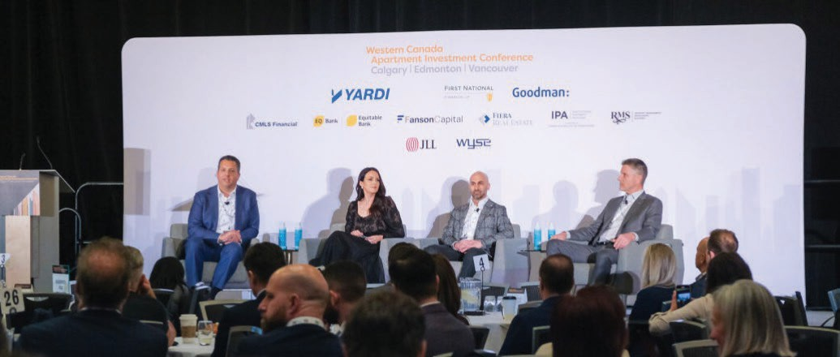
Title
$25,000
One Exclusive opportunity
DESCRIPTION AND SPONSOR BENEFITS
Highest level of visibility during the event promotion campaign and during the Conference
Logo on lanyard or prominent position on conference name badge (if clip badge is used)
Verbal thank you with logo on screen
Extensive logo exposure, on Toronto Real Estate Forum add on events webpage, Canadian Real Estate Forum portal, eblasts when event is being promoted, social media above other premium sponsors – Platinum and Gold
20 second promotional video (with low audio) – to be played intermittently during logo loop during walk in and walk out
During breakfast when attendees arrive until the conference is opened – at least six times
On the screen in the plenary room during morning refreshments (for those attendees that remain in the conference room) – at least one time
On the screen in the plenary room during luncheon (for those attendees that remain in the conference room) – at least six times
The sponsor is responsible for all costs associated with the production of the video – the organizers must receive the show ready video file at least 10 working days before the event. Videos that are over 20 seconds will be rejected (without refund)
Opportunity to provide a single page (includes text & graphics) article for inclusion in the digital Canadian Real Estate Forums Magazine – Winter 2026 edition. Subject and theme will relate to conference content and will avoid corporate promotion
Logo on organizer advertisement in Canadian Real Estate Forum Magazine - Fall 2026 edition
Opportunity for sponsoring organization to Chair the event
REGISTRATION
Five Apartment Development & Affordable Housing Conference Registrations (value $7,245)
VALUE ADDED BENEFITS
Logo exposure on the Toronto Real Estate Forum website – add-on events page
Placement of logo on Thank You to Sponsors of Apartment Development & Affordable Housing Conference banner in the Canadian Real Estate Forums Magazine – Winter 2026 edition
Social Media (Linked-In & X)
On social media posts made across LinkedIn (18,000+ followers) and in addition X when the event is being promoted
Canadian Real Estate Forums Portal
Logo with sponsor level acknowledgement on Canadian Real Estate Forums portal “Hero Banner” on run up to event when this event is being promoted.
RealNews
Mention in Canadian Real Estate Forums newsletter (RealNews) when this event is promoted.
Website
High profile logo placement with sponsor acknowledgement on the Toronto Real Estate Forum Conference website add-on events page with Platinum and other premium sponsors.
Onsite
On stage banner behind speakers for the duration or picture in picture banner along bottom of screen – together with Platinum and other premium sponsors
Logo on walk-in & walk out loop on screen – i.e., breakfast, morning refreshments, lunch
Prominent placement of your logo on directional signage at the convention centre
On thank you to sponsors signage
Logo on walk-in & walk out loop on screen – i.e., breakfast, morning refreshments, lunch
Real Estate Forum – Chairs’ Reception – 1,500 attendees
5 invitations for colleagues and guests to the Real Estate Forum Chairs’ Reception, Fairmont Royal York, December 1, 2026
Database of Conference Delegates
A database of all Conference attendees (excluding email address) will be provided immediately prior to as well as following the event. This list is for your company’s use only and not to be distributed, recirculated, shared or used along with any other third-party organization or event
Reporting
A custom report outlining deliverables of your sponsorship will be made available upon request.

Slide 5

Platinum
$20,000 each
Four opportunities
DESCRIPTION AND SPONSOR BENEFITS
High level of visibility during the event promotion campaign and during the Conference
Logo on conference name badge Verbal thank you with logo on screen
Extensive logo exposure, on Toronto Real Estate Forum add on events webpage, Canadian Real Estate Forum portal, eblasts when event is being promoted, social media with other premium sponsors – Title and Gold.
Opportunity to place a half page ad in the Canadian Real Estate Forums magazine – Winter 2026 edition (value $3,500)
Logo on organizer advertisement in Canadian Real Estate Forum Magazine - Fall 2026 edition
IMPORTANT TO NOTE: This level includes the opportunity for one of the sponsor’s leaders OR a client to be considered for inclusion on the program as a speaker — must be good fit from a knowledge perspective the organizers have final decision on acceptance
REGISTRATION
Three Apartment Development & Affordable Housing Conference Registrations (value $4,350) PLUS sponsor speaker will receive a complimentary registration to the event making four (additional value $1,449)
VALUE ADDED BENEFITS
Logo exposure on the Toronto Real Estate Forum website – add-on events page
Placement of logo on Thank You to Sponsors of Apartment Development & Affordable Housing Conference banner in the Canadian Real Estate Forums Magazine – Winter 2026 edition
Social Media (Linked-In & X)
On social media posts made across LinkedIn (18,000+ followers) and in addition X when the event is being promoted
Canadian Real Estate Forums Portal
Logo with sponsor level acknowledgement on Canadian Real Estate Forums portal “Hero Banner” on run up to event when this event is being promoted.
RealNews
Mention in Canadian Real Estate Forums newsletter (RealNews) when this event is promoted.
Website
High profile logo placement with sponsor acknowledgement on the Toronto Real Estate Forum Conference website add-on events page with Title and other premium sponsors.
Onsite
On stage banner behind speakers for the duration or picture in picture banner along bottom of screen – together with Platinum and other premium sponsors
Logo on walk-in & walk out loop on screen – i.e., breakfast, morning refreshments, lunch
Prominent placement of your logo on directional signage at the convention centre
On thank you to sponsors signage
Logo on walk-in & walk out loop on screen – i.e., breakfast, morning refreshments, lunch
Real Estate Forum – Chairs’ Reception – 1,500 attendees
3 invitations for colleagues and guests to the Real Estate Forum Chairs’ Reception, Fairmont Royal York, December 1
Database of Conference Delegates
A database of all Conference attendees (excluding email address) will be provided immediately prior to as well as following the event. This list is for your company’s use only and not to be distributed, recirculated, shared or used along with any other third-party organization or event
Reporting
A custom report outlining deliverables of your sponsorship will be made available upon request.

Slide 6
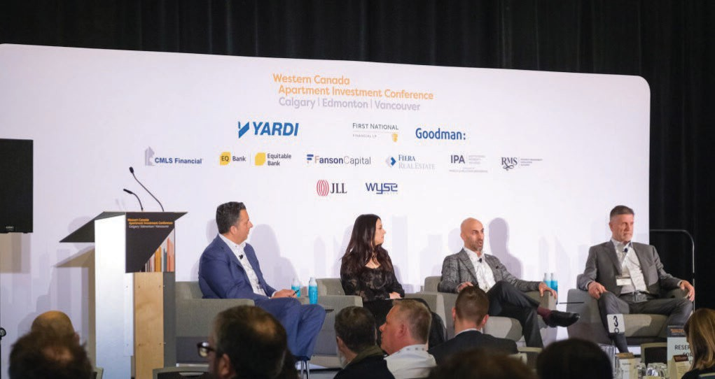

Gold
$8,500 each
Six opportunities
DESCRIPTION AND SPONSOR BENEFITS
High level of visibility during the event promotion campaign and during the Conference
Logo on conference name badge Verbal thank you with logo on screen
Extensive logo exposure, on Toronto Real Estate Forum add on events webpage, Canadian Real Estate Forum portal, eblasts when event is being promoted, social media with other premium sponsors – Title and Platinum.
Logo on organizer advertisement in Canadian Real Estate Forum Magazine - Fall 2025 edition
REGISTRATION
Three Apartment Development & Affordable Housing Conference Registrations (value $4,350)
VALUE ADDED BENEFITS
Logo exposure on the Toronto Real Estate Forum website – add-on events page
Placement of logo on Thank You to Sponsors of Apartment Development & Affordable Housing Conference banner in the Canadian Real Estate Forums Magazine – Winter 2025 edition
Social Media (Linked-In & X)
On social media posts made across LinkedIn (18,000+ followers) and in addition X when the event is being promoted
Canadian Real Estate Forums Portal
Logo with sponsor level acknowledgement on Canadian Real Estate Forums portal “Hero Banner” on run up to event when this event is being promoted
Website
High profile logo placement with sponsor acknowledgement on the Toronto Real Estate Forum Conference website add-on events page with Platinum and other premium sponsors
Onsite
On stage banner behind speakers for the duration or picture in picture banner along bottom of screen – together with other premium sponsors
Logo on walk-in & walk out loop on screen – i.e., breakfast, morning refreshments, lunch
Prominent placement of your logo on directional signage at the convention centre
On thank you to sponsors signage
Real Estate Forum – Chairs’ Reception – 1,500 attendees
3 invitations for colleagues and guests to the Real Estate Forum Chairs’ Reception, Fairmont Royal York, December 2
Database of Conference Delegates
A database of all Conference attendees (excluding email address) will be provided immediately prior to as well as following the event This list is for your company’s use only and not to be distributed, recirculated, shared or used along with any other third-party organization or event
Reporting
A custom report outlining deliverables of your sponsorship will be made available upon request

Slide 7
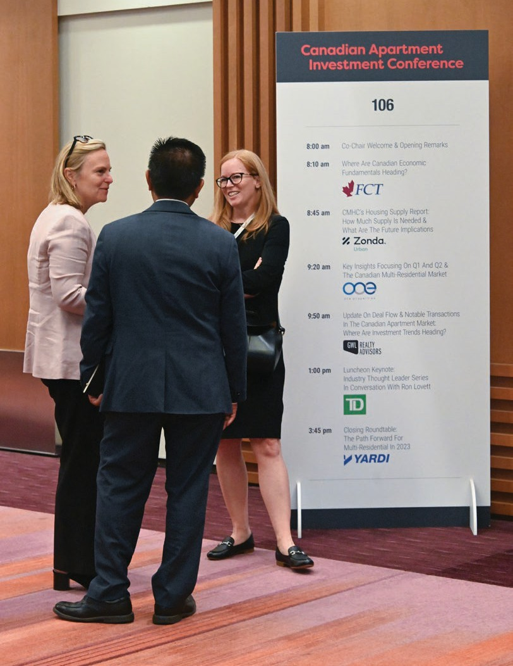

Plenary Session
$6,000 per session
Five opportunities
DESCRIPTION AND SPONSOR BENEFITS
Exclusive sponsorship of one session at this conference chosen on a first come basis from the following:
#1 Session – Special segment for upcoming Federal Budget
#2 Session - Private equity and joint ventures
#3 Session - Apartment Proforma & Financing
#4 Session - Essentials of Feasibility, Design & Lease-up
#5 Session - The Condo Pivot to Rental
Sponsor logo included under session title and before speaker(s) on the program:
On the Real Estate Forums website add-on events page
On program signage outside the conference room under the session sponsored for the duration of the event
Verbal thank you with logo on title slide of the session sponsored – for introduction then again when session concludes
Please note: Session choice is guaranteed only at the point of firm confirmation
REGISTRATION
Two Apartment Development & Affordable Housing Conference Registrations (value $2,900)
VALUE ADDED BENEFITS
Placement of logo on Thank You to Sponsors of Apartment Development & Affordable Housing Conference banner in the Canadian Real Estate Forums Magazine – Winter 2026 edition
Website
Logo placement with sponsor acknowledgement on the Toronto Real Estate Forum Conference website add-on events page as sponsor of this opportunity
Onsite
Logo on thank you to sponsors signage
Real Estate Forum – Chairs’ Reception – 1,500 attendees
2 invitations for colleagues and guests to the Real Estate Forum Chairs’ Reception, Fairmont Royal York, December 1
Database of Conference Delegates
A database of all Conference attendees (excluding email address) will be provided immediately prior to as well as following the event. This list is for your company’s use only and not to be distributed, recirculated, shared or used along with any other third-party organization or event
Reporting
A custom report outlining deliverables of your sponsorship will be made available upon request

Slide 8
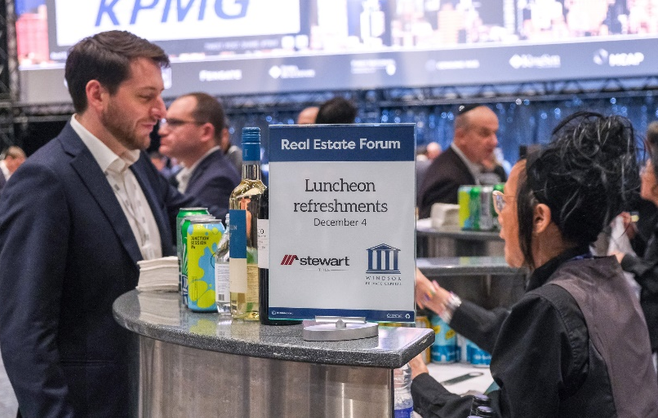
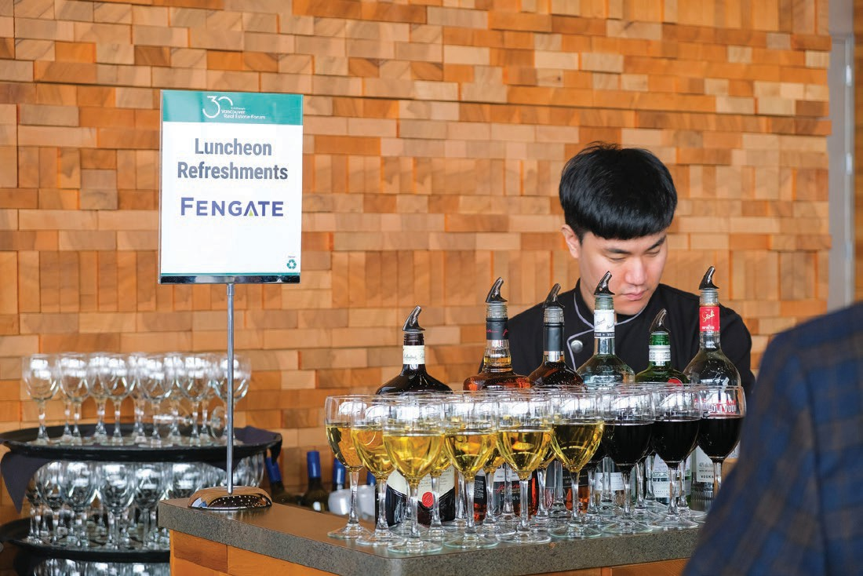
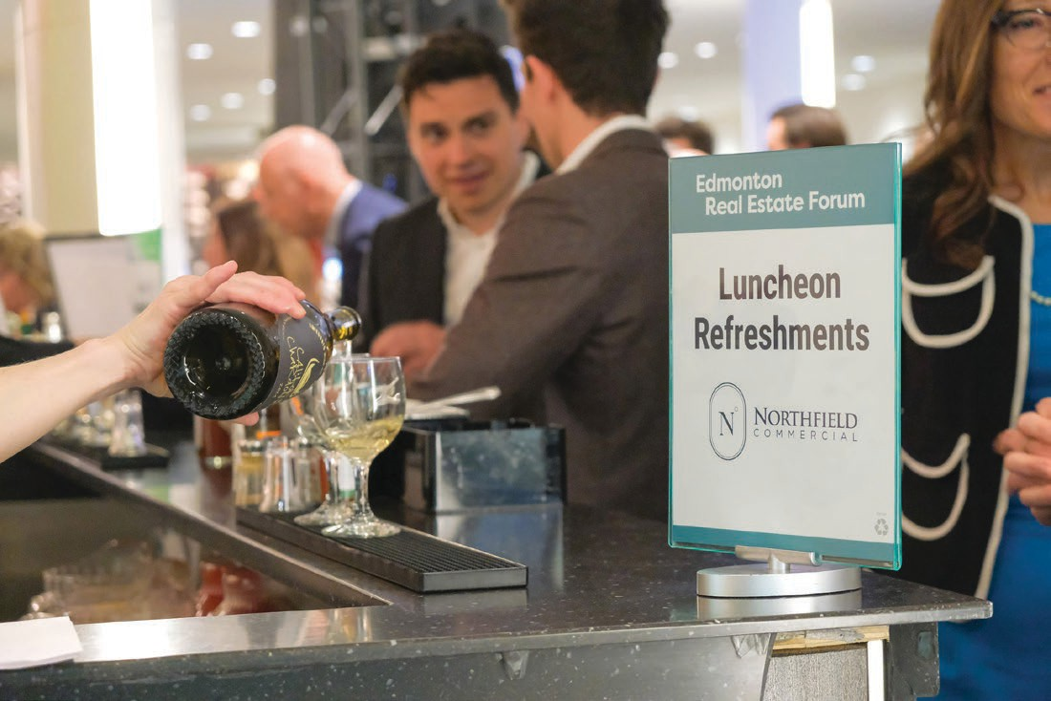
Luncheon & Refreshments
$8,500
Two opportunities
DESCRIPTION AND SPONSOR BENEFITS
Logo on bar signage for duration of luncheon, where a selection of wines, beers, liquors, mixers, and soft drinks will be available
Logo on drink tickets provided to attendees at badge collection on arrival to the conference
Verbal thank you by Chair with logo on screen
Logo exposure on loop as sponsor of this opportunity on screen in conference room during luncheon walk out of the conference and walk in for afternoon sessions
Logo on program on website as sponsor of luncheon refreshments
REGISTRATION
Two Apartment Development & Affordable Housing Conference Registrations (value $2,900)
VALUE ADDED BENEFITS
Placement of logo on Thank You to Sponsors of Apartment Development & Affordable Housing Conference banner in the Canadian Real Estate Forums Magazine – Winter 2026 edition
Website
Logo placement with sponsor acknowledgement on the Toronto Real Estate Forum Conference website add-on events page as sponsor of this opportunity
Onsite
Logo on thank you to sponsors signage
Real Estate Forum – Chairs’ Reception – 1,500 attendees
2 invitations for colleagues and guests to the Real Estate Forum Chairs’ Reception, Fairmont Royal York, December 1
Database of Conference Delegates
A database of all Conference attendees (excluding email address) will be provided immediately prior to as well as following the event. This list is for your company’s use only and not to be distributed, recirculated, shared or used along with any other third-party organization or event
Reporting
A custom report outlining deliverables of your sponsorship will be made available upon request

Slide 9
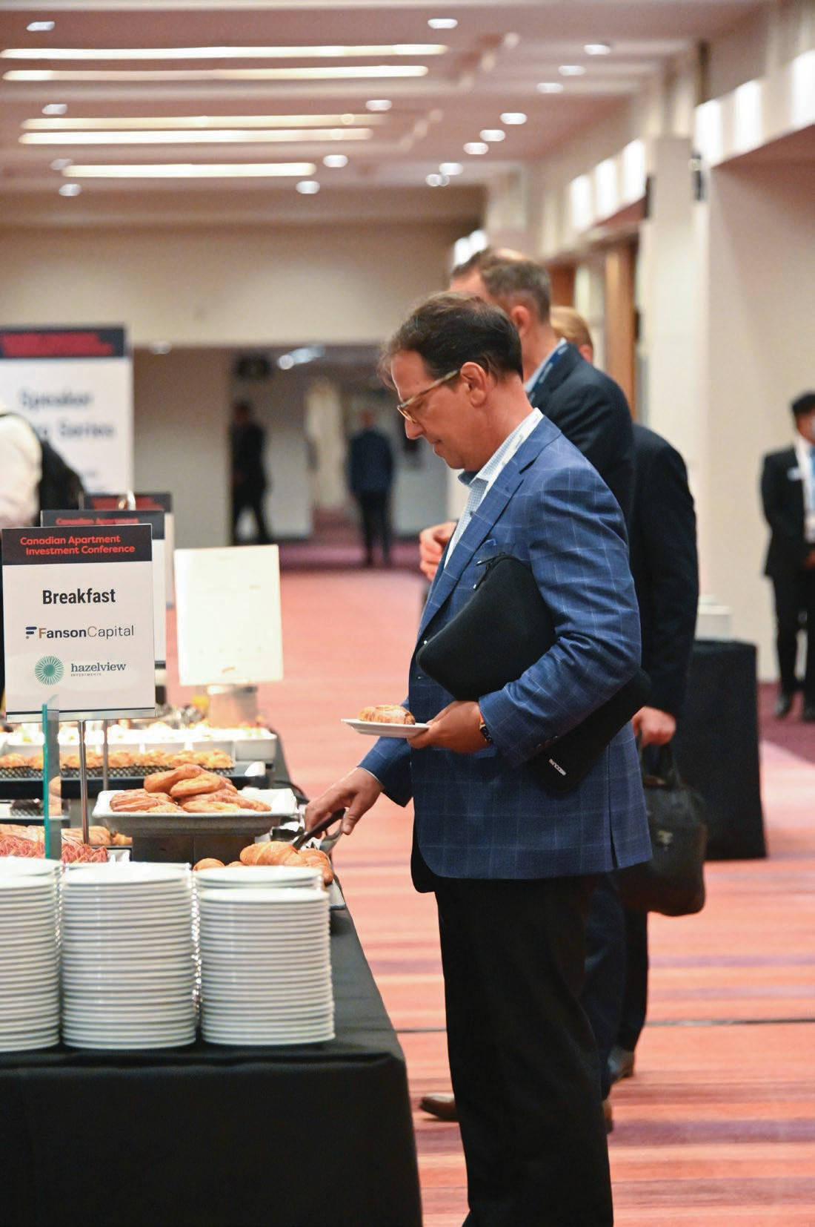
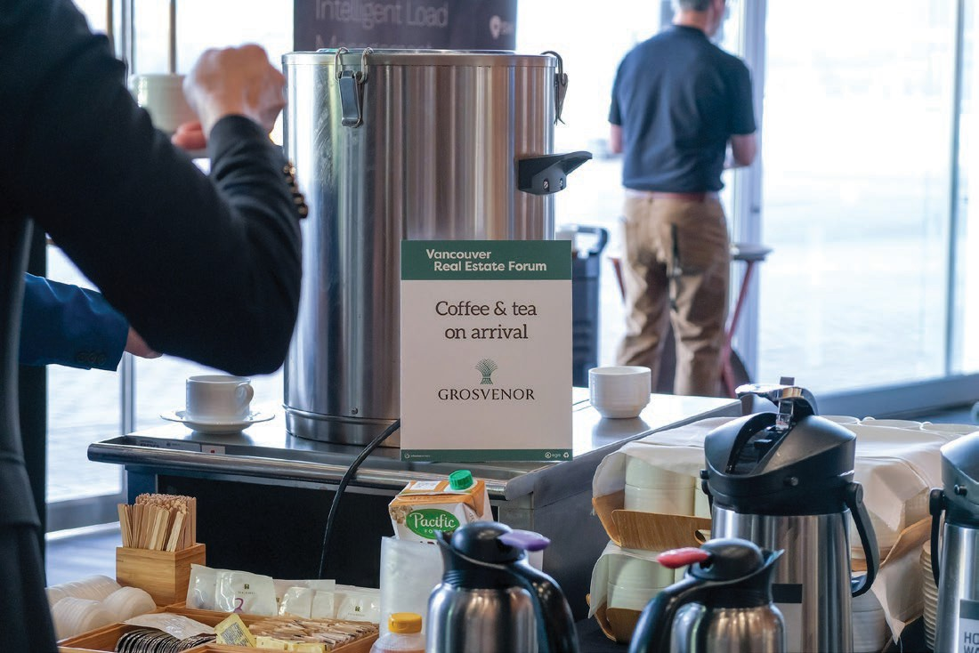

Breakfast + Tea & Coffee
$6,500
Two opportunities
DESCRIPTION AND SPONSOR BENEFITS
Logo on tent card on all tables for the entire duration of continental breakfast buffet and refreshments as sponsor of this opportunity
Logo exposure on loop as sponsor of this opportunity on screen in conference room during morning walk in
Verbal thank you by Chair with logo on screen
Logo on program on website as sponsor of breakfast + tea & coffee
All tables will be set with porcelain service cups and saucers with a thermos of coffee, milk, cream, sugar – tea and decaf will be served by waiting staff on request until Chair opens the conference
REGISTRATION
Two Apartment Development & Affordable Housing Conference Registrations (value $2,900)
VALUE ADDED BENEFITS
Placement of logo on Thank You to Sponsors of Apartment Development & Affordable Housing Conference banner in the Canadian Real Estate Forums Magazine – Winter 2025 edition
Website
Logo placement with sponsor acknowledgement on the Toronto Real Estate Forum Conference website add-on events page as sponsor of this opportunity
Onsite
Logo on thank you to sponsors signage
Real Estate Forum – Chairs’ Reception – 1,500 attendees
2 invitations for colleagues and guests to the Real Estate Forum Chairs’ Reception, Fairmont Royal York, December 2
Database of Conference Delegates
A database of all conference attendees (excluding email address) will be provided immediately prior to as well as following the event. This list is for your company’s use only and not to be distributed, recirculated, shared or used along with any other third-party organization or event
Reporting
A custom report outlining deliverables of your sponsorship will be made available upon request

Slide 10
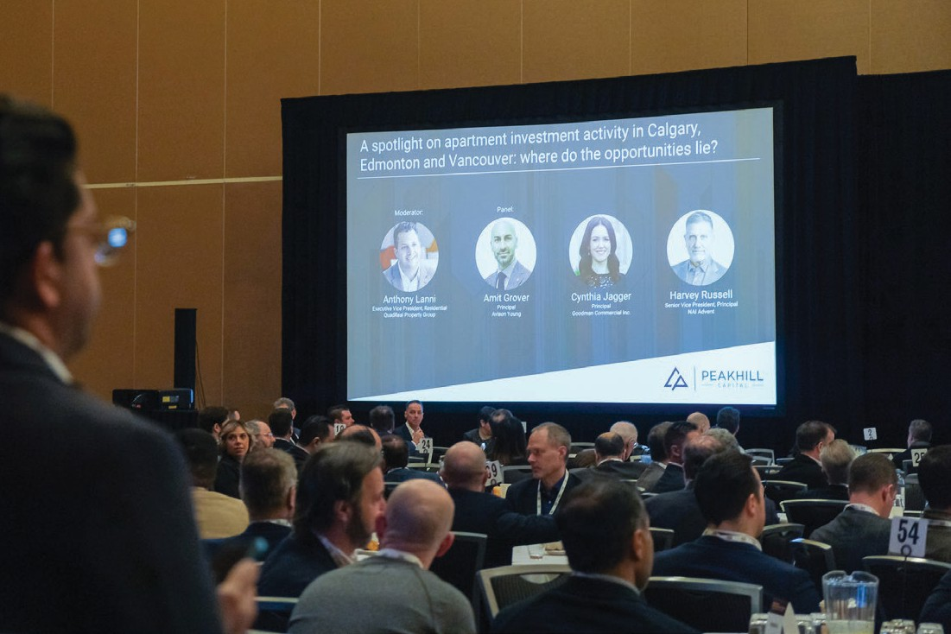
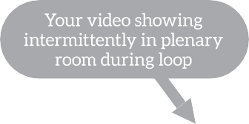
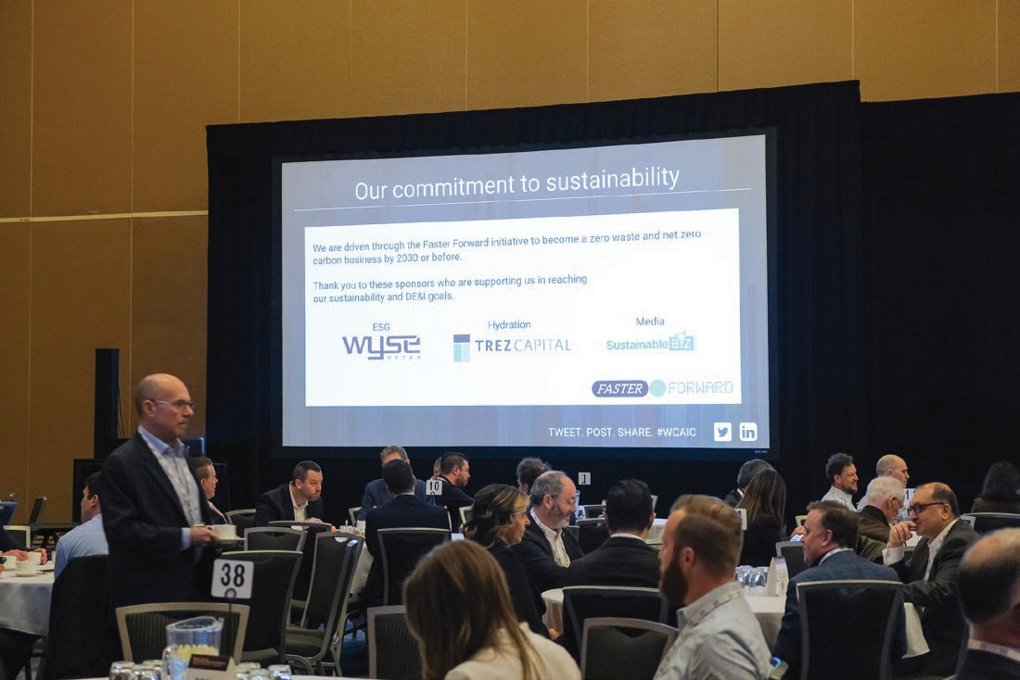

Walk-in Video
$6,000
Three opportunities
DESCRIPTION AND SPONSOR BENEFITS
20 second promotional video (with low audio) – to be played intermittently during logo loop during walk in and walk out
During breakfast when attendees arrive until the conference is opened — at least six times
On the screen in the plenary room during morning refreshments (for those attendees that remain in the conference room) – at least one time
On the screen in the plenary room during luncheon (for those attendees that remain in the conference room) – at least six times
The sponsor is responsible for all costs associated with the production of the video – the organizers must receive the show ready video file at least 10 working days before the event. Videos that are over 20 seconds will be rejected (without refund)
REGISTRATION
Two Apartment Development & Affordable Housing Conference Registrations (value $2,900)
VALUE ADDED BENEFITS
Logo exposure on the Toronto Real Estate Forum website – add-on events page
Placement of logo on Thank You to Sponsors of Apartment Development & Affordable Housing Conference banner in the Canadian Real Estate Forums Magazine – Winter 2026 edition
Website
Logo placement with sponsor acknowledgement on the Toronto Real Estate Forum Conference website add-on events page
Onsite
On thank you to sponsors signage
Real Estate Forum – Chairs’ Reception – 1,500 attendees
2 invitations for colleagues and guests to the Real Estate Forum Chairs’ Reception, Fairmont Royal York, December 1
Database of Conference Delegates
A database of all Conference attendees (excluding email address) will be provided immediately prior to as well as following the event. This list is for your company’s use only and not to be distributed, recirculated, shared or used along with any other third-party organization or event
Reporting
A custom report outlining deliverables of your sponsorship will be made available upon request

Slide 11

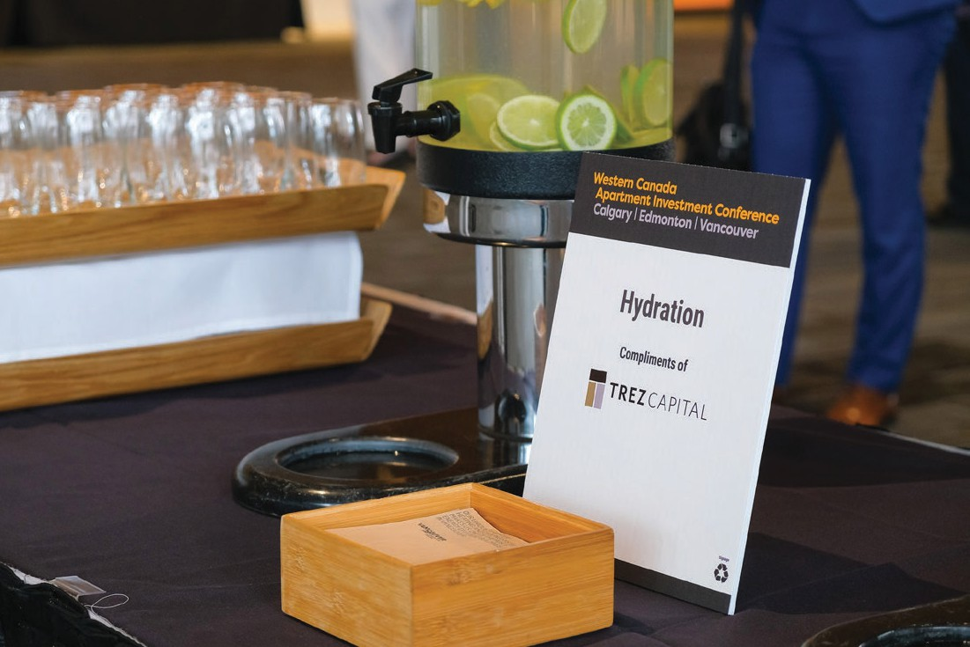
Hydration
$5,500
One opportunity
DESCRIPTION AND SPONSOR BENEFITS
Logo on tent card on all tables until morning refreshments as sponsor of this opportunity
All tables will be set with pitcher of iced water with slices of lemon available for attendees
Logo exposure on loop as sponsor of this opportunity on screen in conference room during morning walk in
Hydration stations with ice and slices of lemon will be placed in the conference room from the end of morning networking and refreshment break for attendees to help themselves.
This will be replenished during the day
Logo on program on website as sponsor of this opportunity
REGISTRATION
Two Apartment Development & Affordable Housing Conference Registrations (value $2,900)
VALUE ADDED BENEFITS
Placement of logo on Thank You to Sponsors of Apartment Development & Affordable Housing Conference banner in the Canadian Real Estate Forums Magazine – Winter 2026 edition
Website
Logo placement with sponsor acknowledgement on the Toronto Real Estate Forum Conference website add-on events page as sponsor of this opportunity
Onsite
Logo on thank you to sponsors signage
Real Estate Forum – Chairs’ Reception – 1,500 attendees
2 invitations for colleagues and guests to the Real Estate Forum Chairs’ Reception, Fairmont Royal York, December 1
Database of Conference Delegates
A database of all Conference attendees (excluding email address) will be provided immediately prior to as well as following the event. This list is for your company’s use only and not to be distributed, recirculated, shared or used along with any other third-party organization or event
Reporting
A custom report outlining deliverables of your sponsorship will be made available upon request

Slide 12

Morning & afternoon refreshments
$6,500
Two opportunities
DESCRIPTION AND SPONSOR BENEFITS
Logo on signage placed on beverage stations set up for morning and afternoon networking break in the foyer and inside the conference room for attendees to help themselves. Once set up these stations in the conference room these will be quietly replenished during the day.
Logo on program on website as sponsor of this opportunity
REGISTRATION
Two Apartment Development & Affordable Housing Conference Registrations (value $2,900)
VALUE ADDED BENEFITS
Placement of logo on Thank You to Sponsors of Apartment Development & Affordable Housing Conference banner in the Canadian Real Estate Forums Magazine – Winter 2025 edition
Website
Logo placement with sponsor acknowledgement on the Toronto Real Estate Forum Conference website add-on events page as sponsor of this opportunity
Onsite
Logo on thank you to sponsors signage
Real Estate Forum – Chairs’ Reception – 1,500 attendees
2 invitations for colleagues and guests to the Real Estate Forum Chairs’ Reception, Fairmont Royal York, December 1
Database of Conference Delegates
A database of all conference attendees (excluding email address) will be provided immediately prior to as well as following the event. This list is for your company’s use only and not to be distributed, recirculated, shared or used along with any other third-party organization or event
Reporting
A custom report outlining deliverables of your sponsorship will be made available upon request
Your logo on a sign during morning refreshments for remainder of day

Slide 13

Pen
$5,000
One opportunity
DESCRIPTION AND SPONSOR BENEFITS
Exclusive sponsorship of a quality pen with sponsor logo made available to all attendees on arrival to the conference
REGISTRATION
Two Apartment Development & Affordable Housing Conference Registrations (value $2,900)
VALUE ADDED BENEFITS
Placement of logo on Thank You to Sponsors of Apartment Development & Affordable Housing Conference banner in the Canadian Real Estate Forums Magazine – Winter 2025 edition
Website
Logo placement with sponsor acknowledgement on the Toronto Real Estate Forum Conference website add-on events page as sponsor of this opportunity
Onsite
Logo on thank you to sponsors signage
Real Estate Forum – Chairs’ Reception – 1,500 attendees
2 invitations for colleagues and guests to the Real Estate Forum Chairs’ Reception, Fairmont Royal York, December 1
Database of Conference Delegates
A database of all conference attendees (excluding email address) will be provided immediately prior to as well as following the event. This list is for your company’s use only and not to be distributed, recirculated, shared or used along with any other third-party organization or event
Reporting
A custom report outlining deliverables of your sponsorship will be made available upon request

Slide 14

Journal
$5,000
Two opportunities
DESCRIPTION AND SPONSOR BENEFITS
Sponsorship of a quality writing journal for notes with sponsor logo(s) on the front cover made available to all attendees on arrival to the conference
REGISTRATION
Two Apartment Development & Affordable Housing Conference Registrations (value $2,900)
VALUE ADDED BENEFITS
Placement of logo on Thank You to Sponsors of Apartment Development & Affordable Housing Conference banner in the Canadian Real Estate Forums Magazine – Winter 2025 edition
Website
Logo placement with sponsor acknowledgement on the Toronto Real Estate Forum Conference website add-on events page as sponsor of this opportunity
Onsite
Logo on thank you to sponsors signage
Real Estate Forum – Chairs’ Reception – 1,500 attendees
2 invitations for colleagues and guests to the Real Estate Forum Chairs’ Reception, Fairmont Royal York, December 2
Database of Conference Delegates
A database of all conference attendees (excluding email address) will be provided immediately prior to as well as following the event. This list is for your company’s use only and not to be distributed, recirculated, shared or used along with any other third-party organization or event
Reporting
A custom report outlining deliverables of your sponsorship will be made available upon request

Slide 15
Sponsorship Special Terms
In order to receive complimentary registrations your invoice must be paid in full
The promo-code for the complimentary registration(s) must be utilized at least 10 working days from the start date of the event – otherwise it/they are forfeit
Names for Real Estate Forum Chairs’ Reception guests must be advised at least 10 working days from the start date of the event – or they are deemed forfeit
Exceptions to the above must be requested by the sponsor 15 working days from the start date of the event. If feasible the organizers will accommodate
For sold out events complimentary registrations associated with this sponsorship will be released 9 days pre-event to those wait listed.
In order to receive attendee database your invoice must be paid in full
All transactions must be processed in Canadian funds
All images included in this prospectus are examples only

