Slide 1
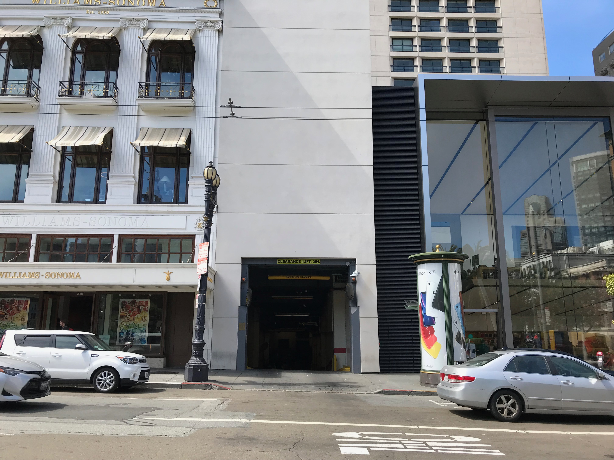
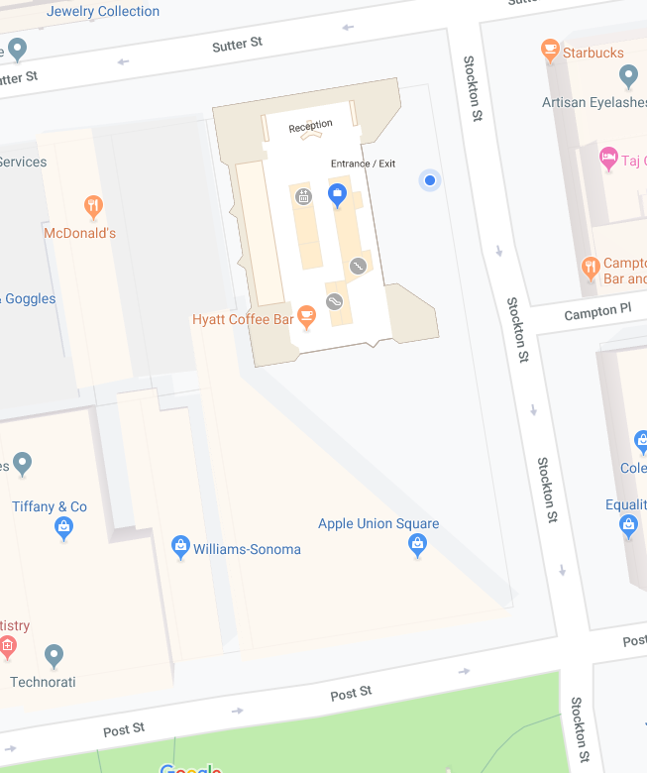
LOADING DOCK INFORMATION
GRAND HYATT SAN FRANCISCO
345 Stockton Street
San Francisco, CA 94108
T
+1 415 848 6074
F
+1 415 848 6091
sanfrancisco.grand.hyatt.com
ACCESSING OUR LOADING DOCK
The entrance to the Loading Dock is located on 320 Post Street in between the Williams-Sonoma and Apple Store.
The Loading Dock clearance height is 12' 3“. The Dock can only allow Vans or Straight Trucks up to 26’.
Semi Trucks and Trailers must park their vehicles on the street and deliver their items down the ramp.
(See SFMTA Permit Process for Post St. meters)
Load-in is available after 11:00 AM from Monday through Friday or Weekends.
All other time frames must be scheduled in advance through your Event Manager. Any changes, or delays in your schedule need to be sent to the manager to ensure that they do not conflict with other hotel related deliveries that are currently scheduled.
Grand Hyatt San Francisco
Loading Dock
UNLOADING YOUR VEHICLE
Check-in with Security and provide company information and delivery location.
Our Event Services team will assist with further instructions.
All vehicles MUST be relocated after load in/out. See SFMTA.com for parking options.
Unloading Heavy items? The delivery truck must have a lift gate or provide a fork lift to unload at the Loading Dock. All moving equipment such as dollies, flat beds, etc. should be supplied on own.
Fork lifts are not allowed to be used inside the hotel Freight Elevator.
Notes:
Registered/® Legal Usage: U.S., Canada, Caribbean, Mexico, Chile, Costa Rica, Guatemala and Nicaragua

Slide 2
LOADING DOCK INFORMATION
GRAND HYATT SAN FRANCISCO
345 Stockton Street
San Francisco, CA 94108
T
+1 415 848 6074
F
+1 415 848 6091
sanfrancisco.grand.hyatt.com
ACCESSING OUR LOADING DOCK
The entrance to the Loading Dock is located on 320 Post Street in between the Williams-Sonoma and Apple Store.
Exhibitor Information
Exhibitors bringing boxes, equipment, or extensive collateral must enter through our loading dock at 320 Post Street.
Upon arrival, they must check in with our hotel services team and mention that they are setting up in the Ballroom Foyer.
Exhibitors must bring their own carts, dollies etc for transporting their items to the event location.
Hotel Services Team will guide exhibitors to the appropriate elevators and ramps to reach their destination .
***Anyone entering through the main hotel entrance with substantial setup equipment will be redirected to the loading dock. Attached are the directions for their convenience.
Grand Hyatt San Francisco
Loading Dock
UNLOADING YOUR VEHICLE
Check-in with Security and provide company information and delivery location.
Our Event Services team will assist with further instructions.
All vehicles MUST be relocated after load in/out. See SFMTA.com for parking options.
Unloading Heavy items? The delivery truck must have a lift gate or provide a fork lift to unload at the Loading Dock. All moving equipment such as dollies, flat beds, etc. should be supplied on own.
Fork lifts are not allowed to be used inside the hotel Freight Elevator.
Notes:
Registered/® Legal Usage: U.S., Canada, Caribbean, Mexico, Chile, Costa Rica, Guatemala and Nicaragua

