Slide 1
Sponsor Guide
Front End of Innovation 2025

Slide 2
Table Of Contents
Please click on a link below to go to directly to that section of the guide.
How to Edit your Virtual Booth | Details (Slides 3 – 8)
How to Edit your Virtual Booth | Videos (Slides 9 – 11)
How to Edit your Virtual Booth | Downloads (Slides 12 – 13)
How to Edit your Virtual Booth | Staff (Slide 14)
How to Download QR codes for your Documents (Slides 15 – 16)
How to Edit your Personal Profile (Slides 17 – 18)
Lead Retrieval (Slides 19 – 26)
Your Alchemy Dashboard (Slides 27 – 29)
Your Event Contacts (Slide 30)

Slide 3
ConnectMe Guide:
How to Edit Virtual Booths

Slide 4
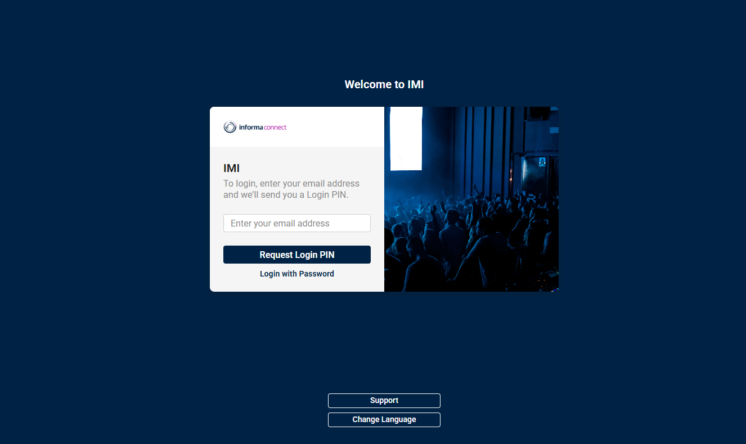
STEP 1 – LOGIN TO PLATFORM
Link to online platform: https://imi.connectmeinforma.com/
Please use the login details you have received by email.
Enter your email.
You will be emailed a 4-digit code that will redirect you to the platform. Please contact us if you do not receive the email. It will come from register@totem-app.com

Slide 5
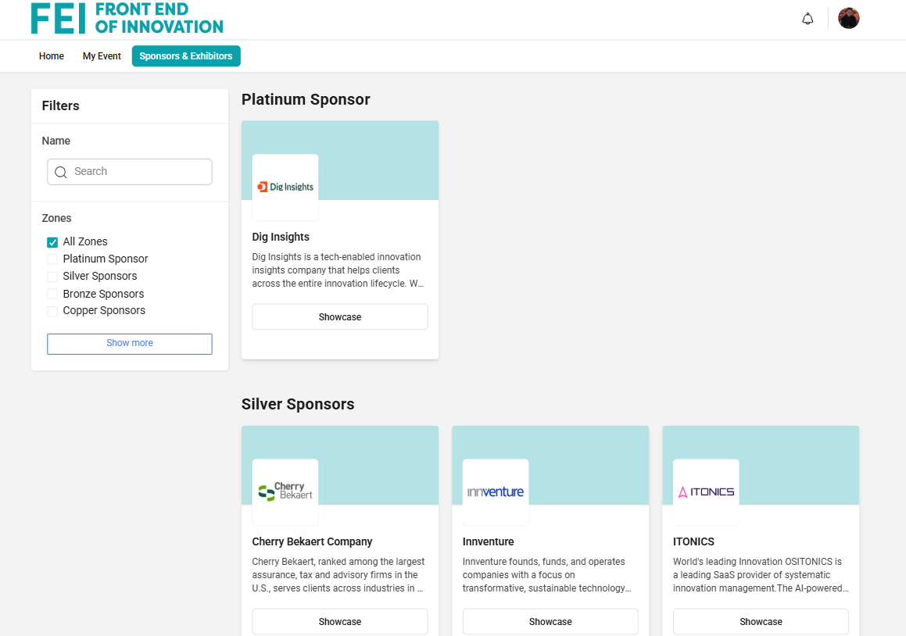
STEP 2 – FIND YOUR BOOTH
Click on Sponsors & Exhibitors to see a list of all sponsors and partners.
Search for your company name
Click on “Showcase” to access the booth.

Slide 6
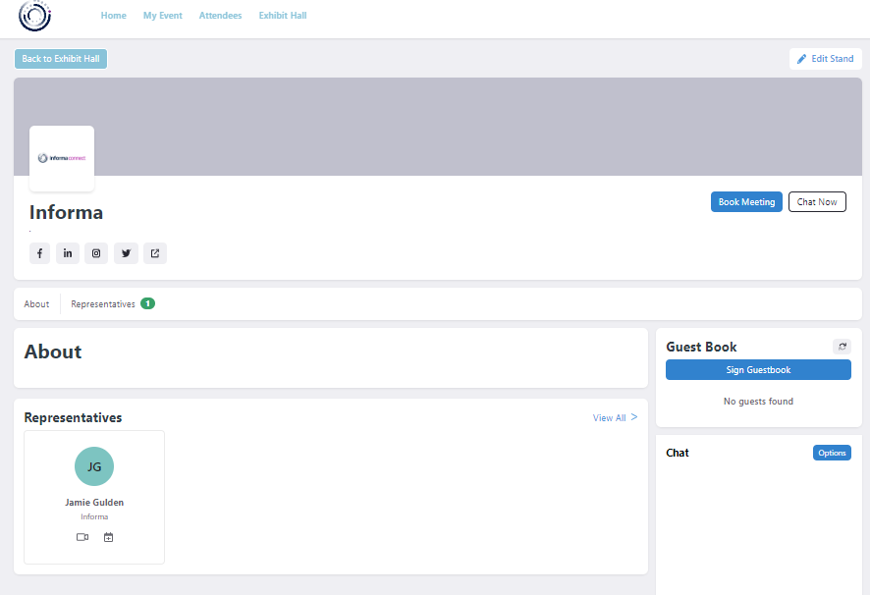


STEP 3 – BUILD YOUR BOOTH
You can change the settings, by clicking on “Edit Stand”. Only representatives can edit the booth.
If you don’t have this permission, please send an email to your Informa contact.
Book Meeting & Chat Now: Interactive tools that can be used by attendees to either book a meeting with Reps or send a message on Chat.
Social media links
Representatives: will show all registered staff from your company attending the show (all attendee’s will be registered 2 weeks before the event).
About: short company description
Guest book: Lead capture tool that can be used by attendees. You can export a list of all guests who signed by clicking on the Spreadsheet icon.

Slide 7
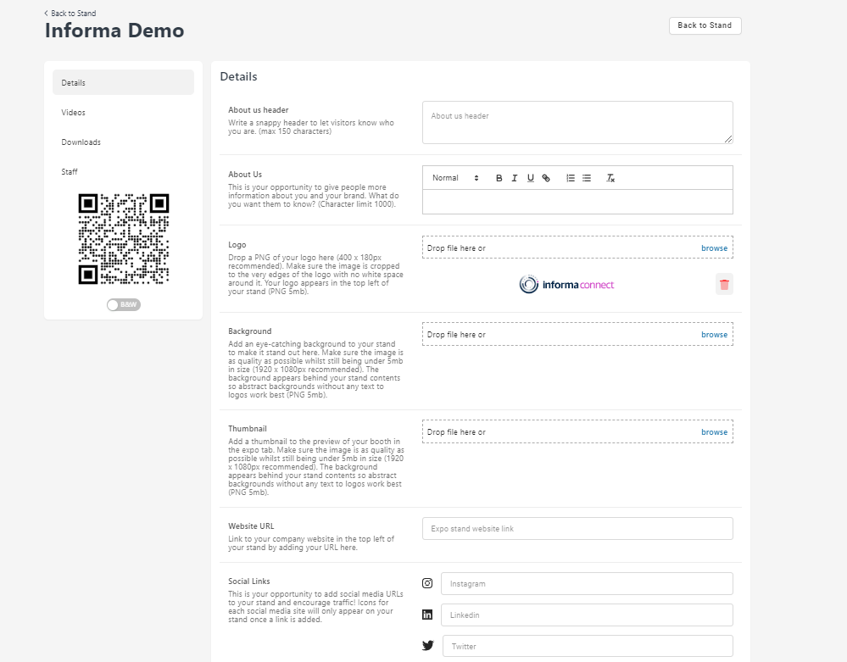
STEP 4 – BUILD YOUR BOOTH
Details: An overview of your booth. You can edit all your company details such as 'About Us', 'Logo', 'Background', etc. Specs are listed besides each editable option.
Don’t forget to save your changes by clicking on “Update About Us” at the bottom of the page.
Background: 3750x450px recommended. The background appears at the top of your stand so abstract backgrounds without any text to logos work best.
Thumbnail: 765x360px, will go in the lobby of the sponsor page- we will provide one for you if you choose not to add one of your own.

Slide 8
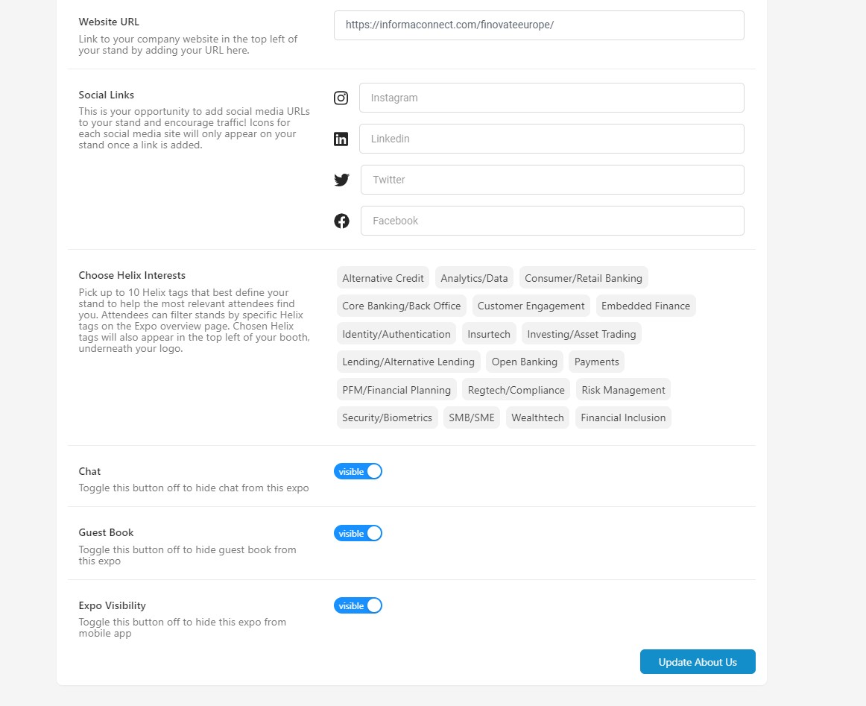
Website & Social links: The links must include the prefix https://
Helix Tags: If these have been provided for the event, pick up to 10 Helix tags that best define your stand to help the most relevant attendees find you. Attendees can filter stands by specific Helix tags on the Expo overview page. Chosen Helix tags will also appear in the top left of your booth, underneath your logo.
Chat & Guest book list: Interactive tools. We recommend keeping both of these toggled on.
Expo Visibility: I do not believe you will have this button, but if you do, please leave it toggled on
Don’t forget to save your changes by clicking on “Update About Us”

Slide 9
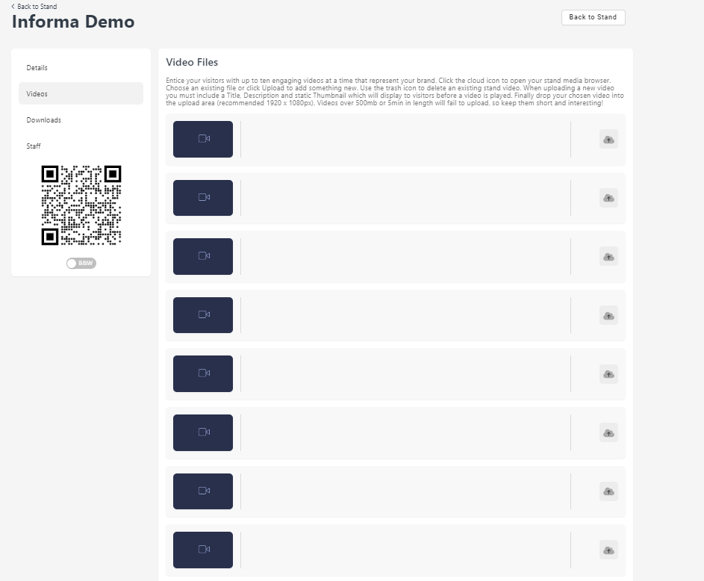
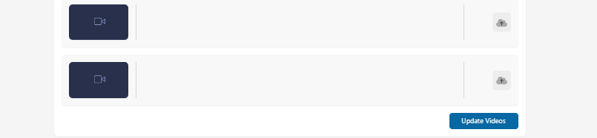
STEP 5 – ADD NEW VIDEOS
Videos: An overview of all your videos. To add new videos please click on the icon highlighted.
Don’t forget to save all changes by clicking on “Update Videos”

Slide 10
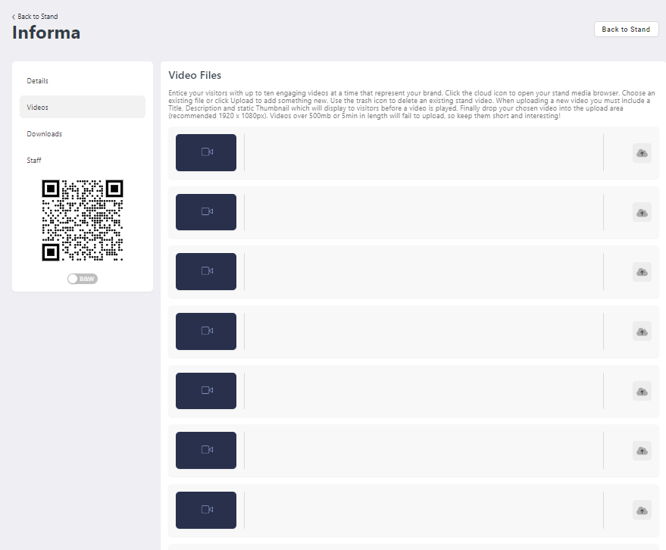
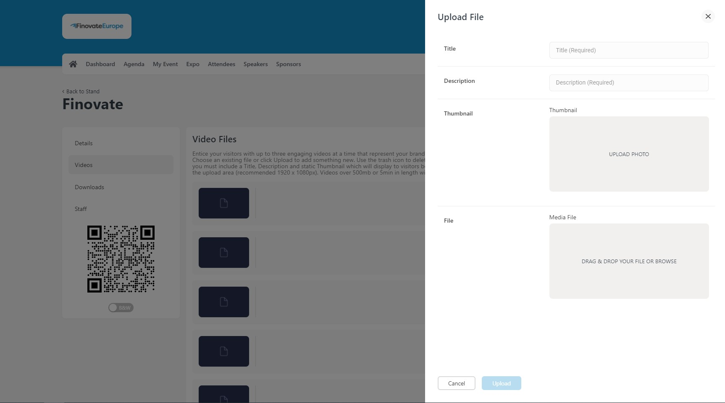
STEP 5 CONT.– ADD NEW VIDEOS
Add all required information – Title, description, thumbnail and the file.
Thumbnail: Pause your video and take a snapshot of the video (5MB PNG image).

Slide 11
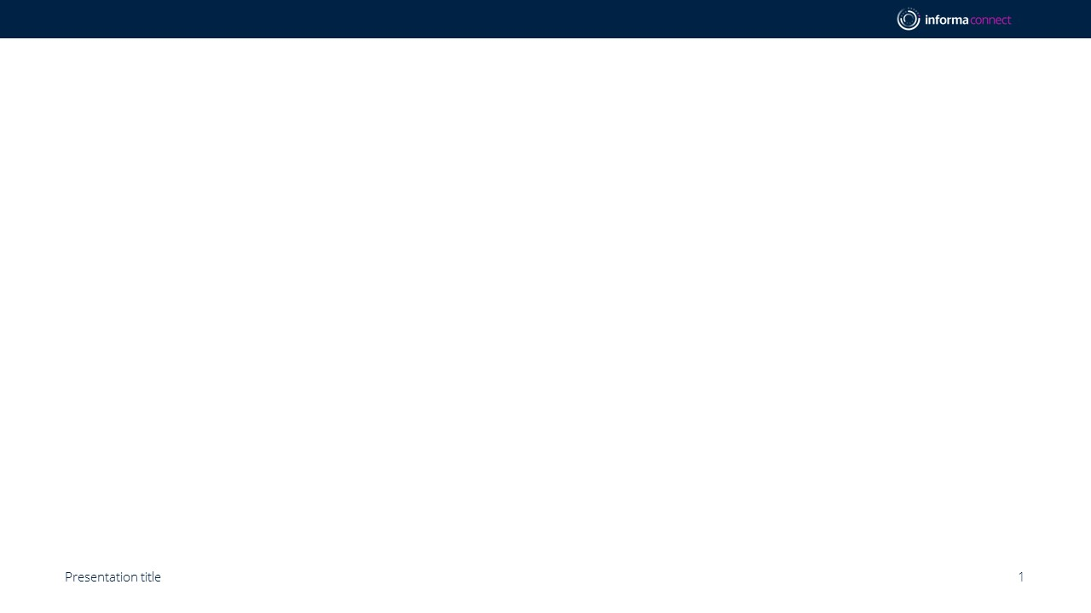
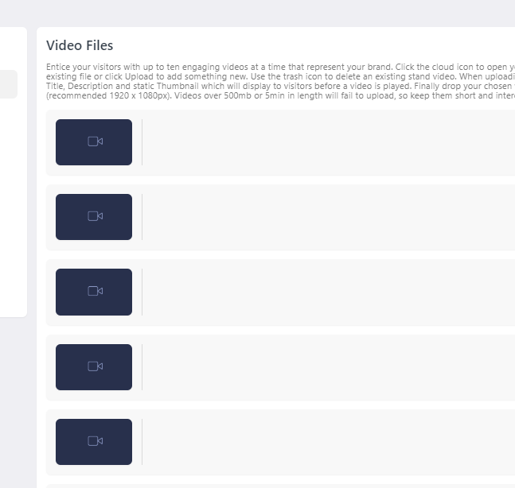
STEP 5 CONT. – ADD NEW VIDEOS
Select the file in the library and press “Confirm Selection.”

Slide 12
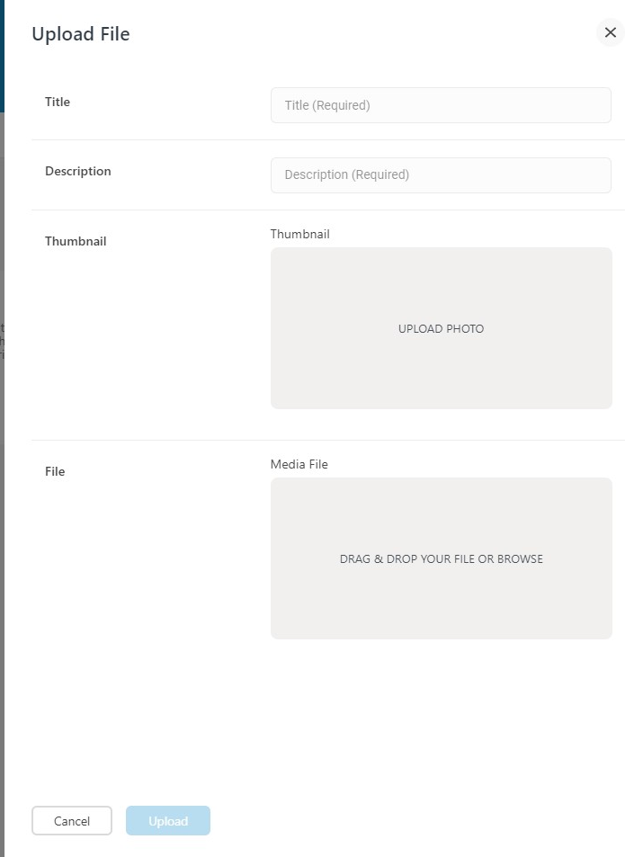
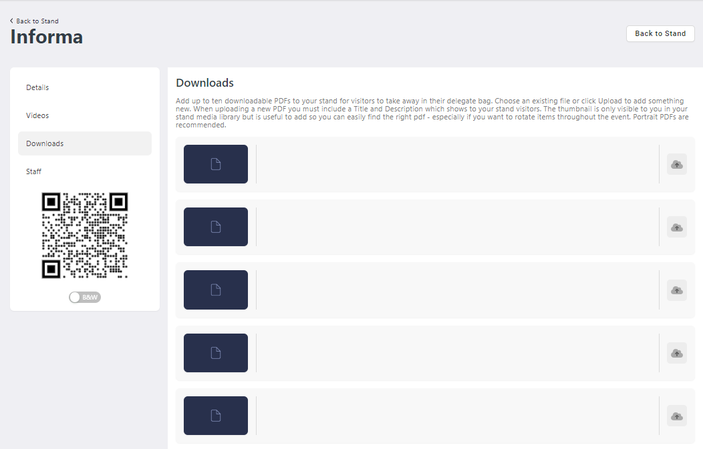
STEP 6 - ADD DOWNLOADABLE DOCUMENTS
Downloads: Add up to 10 downloadable PDFs to your stand.
Choose an existing file or click “the Icon” to add something new. Click the upload button to add.
Add all required information (title, description, thumbnail and file).
Thumbnail:, add a screenshot of the first page. Without a thumbnail, the image will be black on the front end (5MB PNG image).
Portrait downloadable PDFs are recommended.

Slide 13
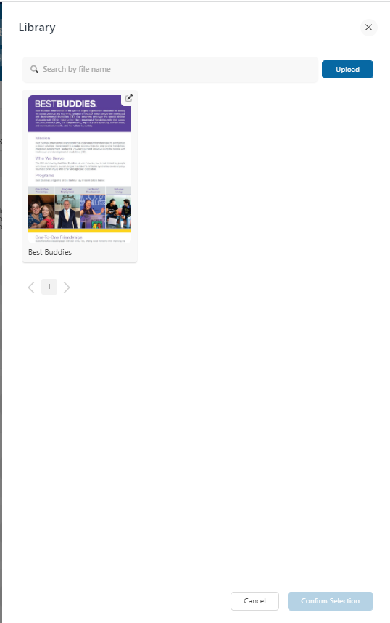
STEP 6 CONT. – ADD DOWNLOADABLE DOCUMENTS
Select the file in the library and press “Confirm Selection”.
Your new document will appear on this page.
You can always come back to this page and edit the title and description if needed.

Slide 14
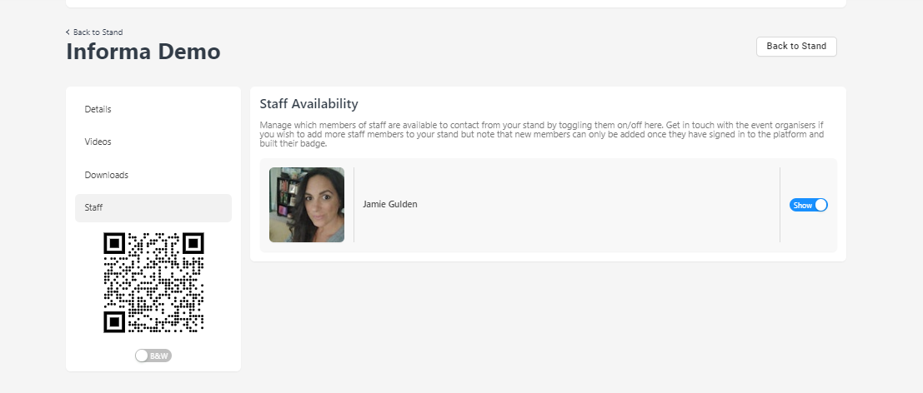
STEP 7 – MANAGE STAFF AVAILABILITY
Staff: Manage staff availability by toggling them on/off.
All staff will appear here when the platform is launched if registered when the platform launches

Slide 15
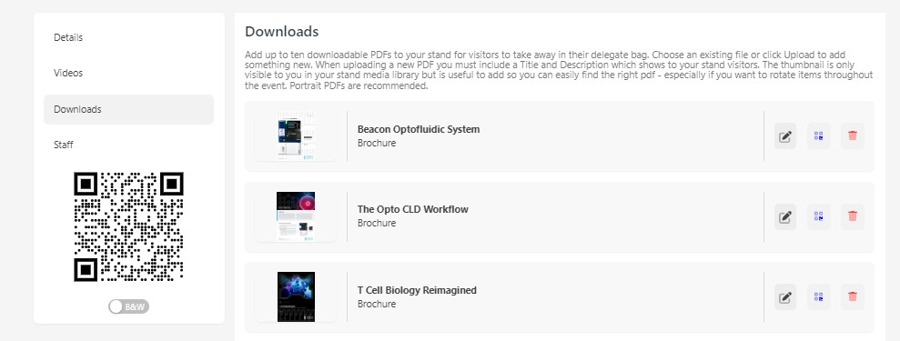
STEP 8 – QR CODES
You can print a QR code which can be scanned by attendees onsite at your booth to download your documents for later viewing. All downloads come in 1 file
Information Classification: General

Slide 16

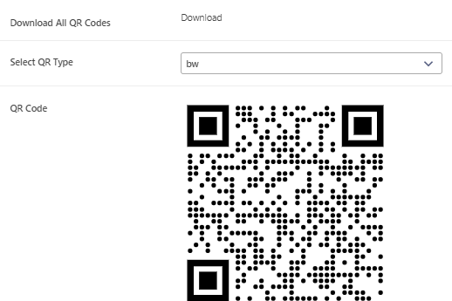
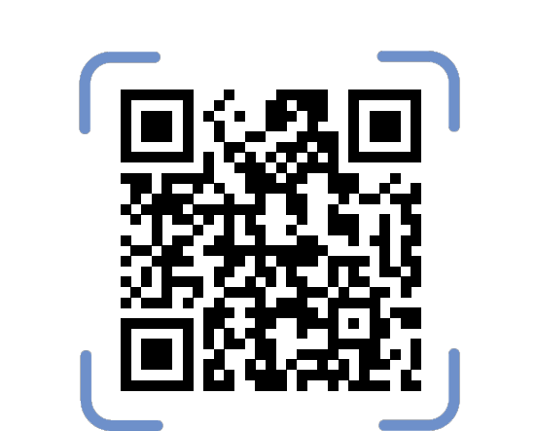
STEP 8 – QR CODES (cont’d)
When you click download, all your uploaded documents will be linked to the respective QR codes for you to print and bring onsite.
Information Classification: General

Slide 17
ConnectMe Guide:
How to Edit your Personal Profile

Slide 18
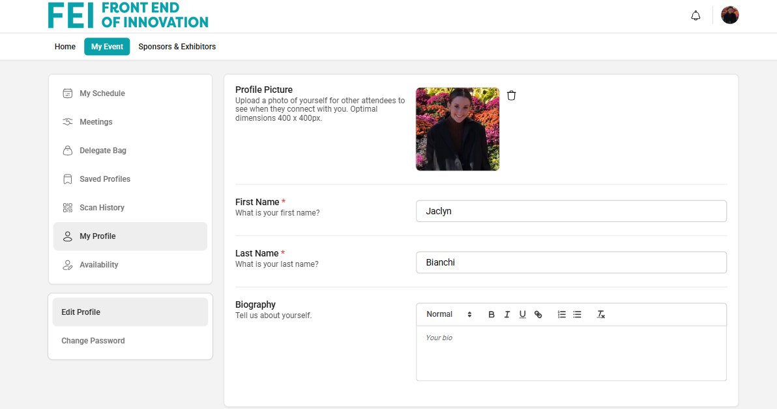
STEP 1 – EDIT MY PROFILE
To edit your profile, go to My Event in the Navigation Bar and select My Profile.
To change/add a photo, click on the profile picture icon. Images should be no larger than 500x500px.
You can also change your password, time zone, job title etc. here too.

Slide 19
Lead Retrieval

Slide 20
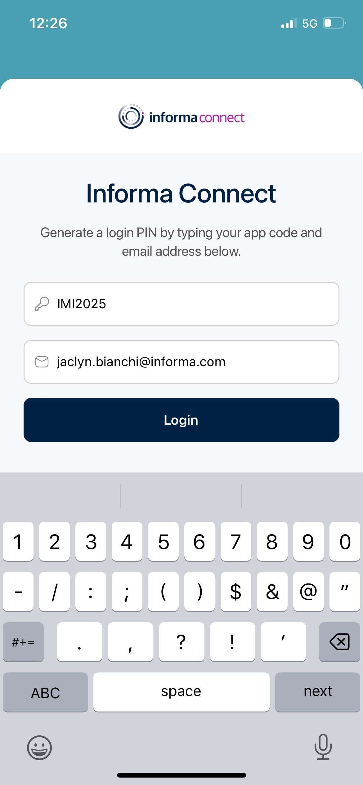
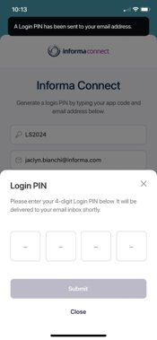
LEAD RETRIEVAL – HOW TO SETUP, SCAN AND COLLECT LEADS ONSITE
On your personal device, please download the ConnectMe app. To find it in the App Store / Google Play, please search ‘ConnectMe by Informa’.
Once downloaded, please enter the event code: IMI2025.
Enter your email address used to register for the conference, to which you will receive a 4-digit pin to login
If you do not receive a 4-digit pin, please email jaclyn.bianchi@informa.com

Slide 21
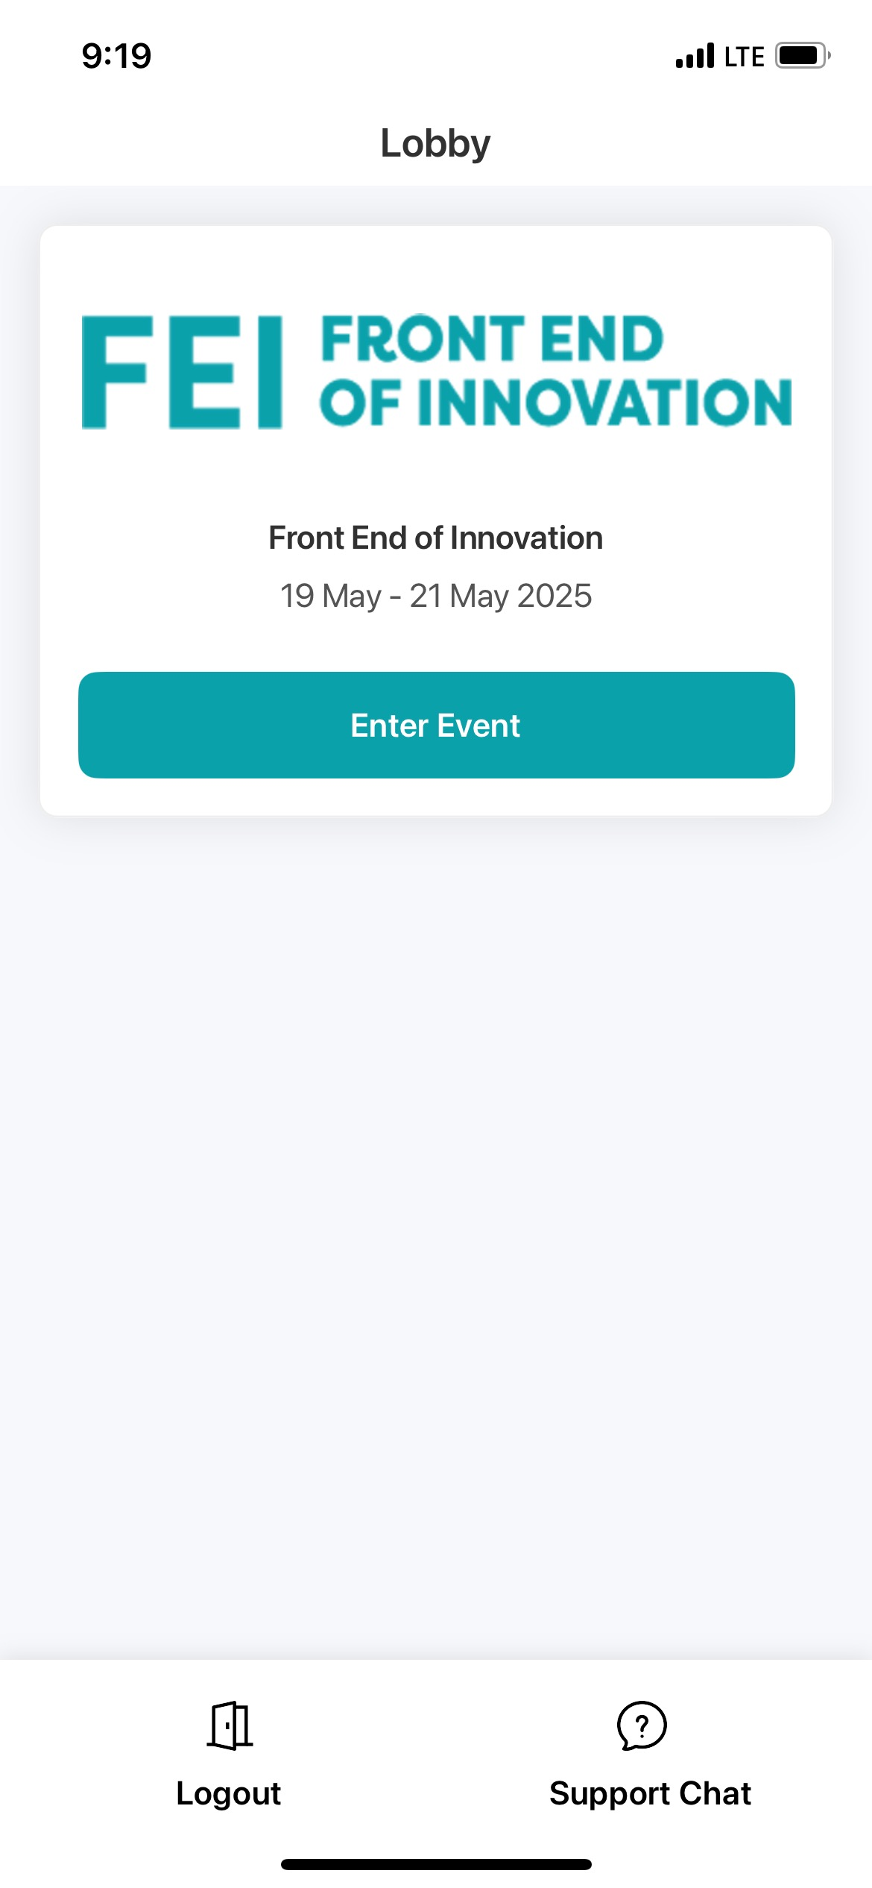
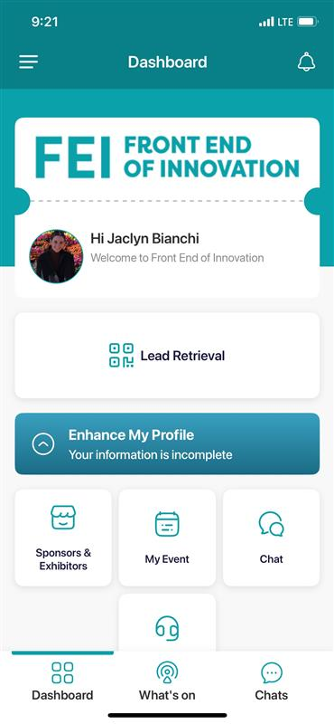
LEAD RETRIEVAL
4. Once entered, please select the Front End of Innovation event to enter. The dashboard on the right should appear and you will have the Lead Retrieval button which will take you to the lead scanning page. This should be visible for you approximately 4 weeks out from the event if you are attending in person.
If you do not see this button on your screen, please contact Sydney Atendido, sydney.atendido@informa.com
and Jaclyn Bianchi, jaclyn.bianchi@informa.com

Slide 22
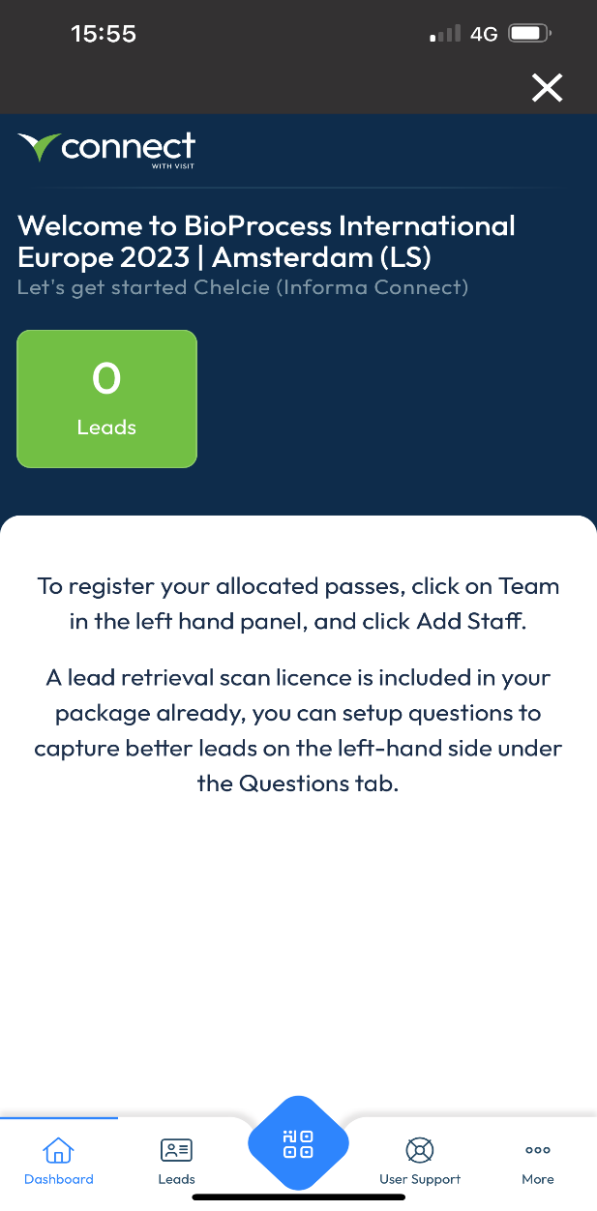
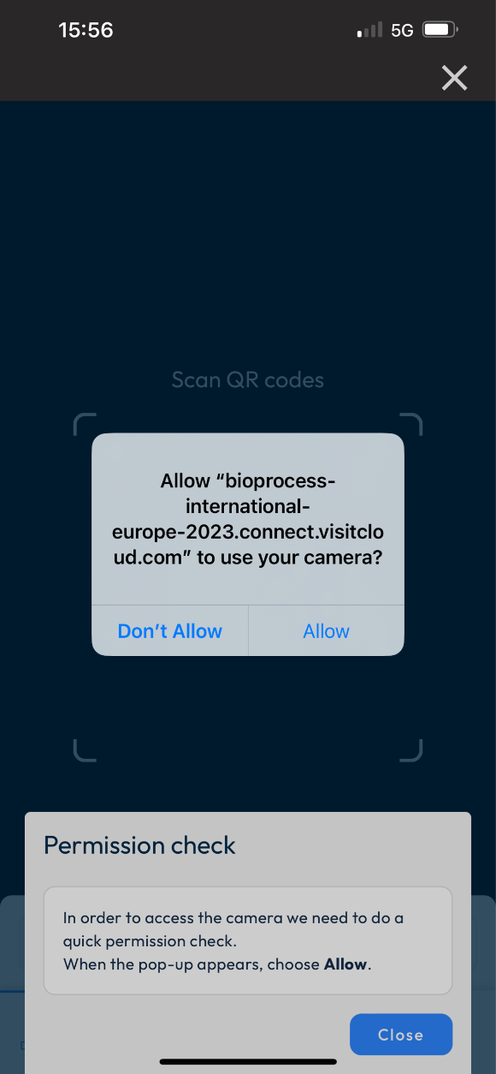
LEAD RETRIEVAL
5. This takes you to the partner portal for capturing leads. To begin scanning click the blue button at the bottom of your screen.
6. Make sure your camera permissions are set to “allowed” in order to scan.
If you do not see this button on your screen, please contact Sydney Atendido

Slide 23
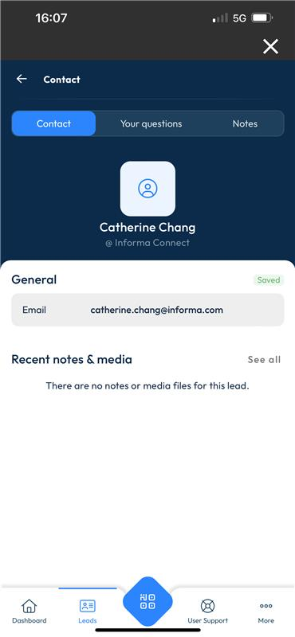
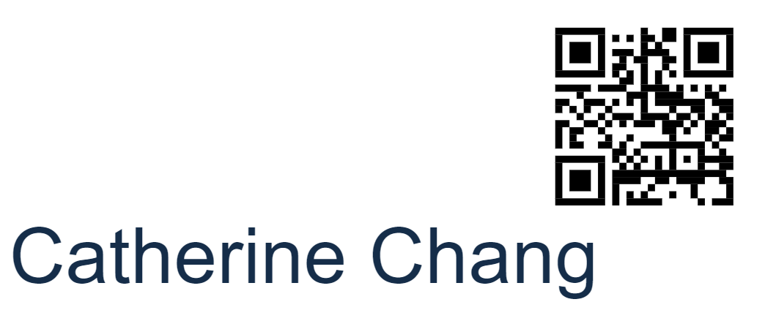
7. Here is an example of a badge with a QR code
LEAD RETRIEVAL
8. These QR codes will be printed on attendee badges onsite which will be easier to scan.
Once scanned, the page will show the attendee details, and you are then able to add your own notes/media files and answer any preset questions.
Click the back button at the top left to go back to your main dashboard, which will show all your scanned leads in one place.

Slide 24
FAQ -LEAD RETRIEVAL
PRE-EVENT
How do I setup my team so that they have access to capture leads?
As the main contact for your team, login to the VISIT Connect portal link sent to you by your operations manager to register your allocated passes for the event. Go to TEAM on the left-hand side navigation bar, and then select Add Staff. Once your team has been entered, they will be automatically setup with access to lead retrieval.
Can I setup custom questions?
Yes – your company’s main contact person can set these for your team via the VISIT Connect portal under Questions.
How many custom questions can we have?
You can have an unlimited amount.
Is there a character limit for the questions I set?
There is a 100-character maximum for questions (including spaces).
When is the deadline for customizing questions?
There is no deadline, you can keep updating questions right up until the event.
Is it possible to get a developer’s kit so that we can use our own lead retrieval system?
No, it is not possible. Lead retrieval for this event can only be used via the system provided through the ConnectMe app. You cannot scan badges with another program.
I want to stop my colleagues attending from downloading leads. Is this possible?
Yes, in your Visit Connect portal, go to TEAM on the left-hand side. Hover your mouse over the attendee whose permission you would like to change and select the Edit icon on the right-hand side. From here, you can change whether that person can: capture leads, export leads, show all leads or have admin permissions.
What does “admin” permission mean?
An Admin user will have access to dashboard, users, profile questions, leads and agenda. This included managing registration and downloading the team’s leads.

Slide 25
FAQ -LEAD RETRIEVAL
DURING THE EVENT
How do I access the lead scanner?
Download ConnectMe by Informa via your smart-device’s app store.
What is the event code for the ConnectMe App?
IMI2025
How do I login to the app?
Enter the email address that was used to register for the event.
How do I scan badges with the ConnectMe App?
Once logged in, on your dashboard you should see a Lead Retrieval button. Click this to begin scanning badges. If you do not see this button, please visit the helpdesk at registration.
Are the leads GDPR compliant?
All attendees are asked an explicit opt-in consent statement as a required stage of the delegate badge process. Please see example here. If your company requires a specific question to be asked, the easiest way of capturing this would be to create a custom question at setup.
Does lead scanning work if there is no internet connection?
Yes, you can still scan badges. The app will synchronise the missing information as soon as you reconnect to the internet. There will be event WiFi available to all attendees.
Can I see the leads I’ve scanned in real-time?
Yes, all the leads you have scanned will show on the lead retrieval dashboard. From there, you can export these leads straight away.
Can I see a consolidated list of leads scanned by my team?
Yes, on the VISIT by GES pass registration portal under Leads, you can view and export your team’s scanned leads. This will show which colleague scanned which delegate line by line.
Can I give permission to my colleagues to view and export all the leads on their devices?
Yes. As an admin user, you can click on the homepage > Team and see all the colleagues who are using Visit Connect. In the Permissions column, there are shown the 4 types of access:
Admin permissions – in this case, the user becomes an admin user
Show all leads – the user will be able to see the leads captured by other team members
Allow capture leads this option is already enabled when a user is registered
Allow export leads – when enabled, the user can export the leads
Require help onsite?
Visit the Helpdesk at registration for all Lead Retrieval Support.

Slide 26
FAQ -LEAD RETRIEVAL
POST EVENT
Where can I find my booth scan leads post-event?
By accessing Visit Connect from a desktop, you can export a .csv file of your team’s leads including any notes that were made. Your main contact from each company can do this.
Will the leads I scanned be sent to me?
Your leads will be consolidated post event by our team and included in your Lead Insights account. You’ll receive instructions for access before the event begins.
What is Lead Insights?
Your dashboard contains all your event lead data in a single view. You will receive an email from Sofia Munoz with directions on how to access your data on the first day of the event. Your dashboard will continue to be updated during and after the event – all accessible through the same login credentials. To enable your colleagues with direct access, just log in, click on your account settings in the top right corner, click “My Team” then add your colleagues so they will receive an automated invitation to set up their accounts. For any questions related to your lead data, contact leadinsights@informa.com
Why doesn’t my Lead Insights dashboard show the booth scan notes my team entered?
All booth scan notes and answers can be found on the VISIT Connect portal. Go to Leads on the left-hand side navigation bar and click Export. This will contain your scan notes. You can also access your booth scan notes via Lead Insights by navigating to the detail page on that individual lead or by exporting all your lead data from the “Data Management” section. Your booth scan notes are not yet available from the “Leads” section export.

Slide 27
Lead Insights

Slide 28
Access your Lead data
Lead Data Details
Your dashboard contains all event lead data in a single view. Pre-event, you will receive an automated email from Lead Insights (leadinsights@informa.com) with instructions for setting up your account. The timing for data to populate your report will vary by event so contact Sofia or your account manager for more details.
Keep in mind that your company’s primary contact also has real-time access to your raw scan data if exported directly from the VISIT platform, which is the only way to access your booth notes. For questions on this contact Sydeny.Atendido@informa.com and Jaclyn.Bianchi@informa.com
Demo Video: https://assets.informa.com/leadinsights/Lead%20Insights%20Demo%20Video.mp4
Lead Insights Benefits: https://assets.informa.com/leadinsights/Benefits.pdf
Third-party Consent Capture Details:
https://assets.informa.com/connectls/SPEX/LeadAnalyticsDashboard/ConnectMe_GDPR-Consent-Capture.pdf

Slide 29
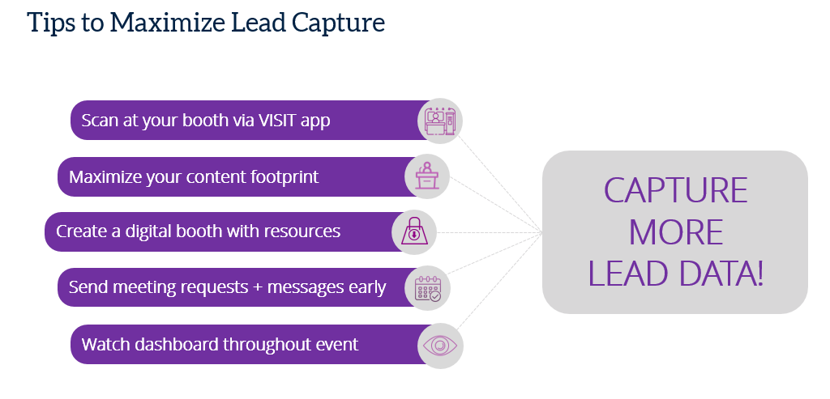

Slide 30
YOUR EVENT CONTACTS
ConnectMe Contact: jaclyn.bianchi@informa.com
Operations Contact: sydney.atendido@informa.com

